Slide 1
Waas Sappening with Latinos/as in América, at the Border, and in Latinx cinema?
Alex tewksbury and mr. Schwed

Slide 2
Born in East la
Produced in 1987, Born in East LA, takes a comedic look at the border of the United States and Mexico.
Basic Plot
3rd generation America, Rudy, is mistakenly deported to Mexico
Rudy works relentlessly to get back home to East LA
Many funny situations occur, but the film also shows some serious problems

Slide 3
Born in East la
The film was written and directed by Cheech Marin
Made famous by his appearances in weed based comedies, starting with Up in Smoke.
https://www.youtube.com/watch?v=CWxgfTMLtc0
He and Tommy Chong created very popular series of movies Cheech and Chong in the early 1980’s
Created the song/music video Born in East LA, that later became his movie.
https://www.youtube.com/watch?v=sFUFw1GH6ic
Marin himself was born in East LA to Mexican parents
His movie parallels himself in many ways.

Slide 4
Public Reception
The film was a box office success and grossed more than $17 million.
Main steam critics trashed the film however because of its poor acting and disjointed/sketch based plot.
Chon Noriega’s essay, “Waas sappening?”, gave it a much more respectable review

Slide 5
“waas sappening” , Noriega
Very well written review that takes a serious approach to understanding Cheech Marin’s comedy, by looking at the films beginning, middle and end .
However, throughout the critique Noriega reads much farther into the scenes than the common viewer ever would.
“Rudy comes to realize that (1) American society views him as more Mexican than American, (2) Mexicans see him as American or pocho, and (3) his attitudes toward women and immigrants have been callous.”
Notes:
https://www.youtube.com/watch?v=W-C5aQT3KVo
https://www.youtube.com/watch?v=PN5-zgyLtAw

Slide 6
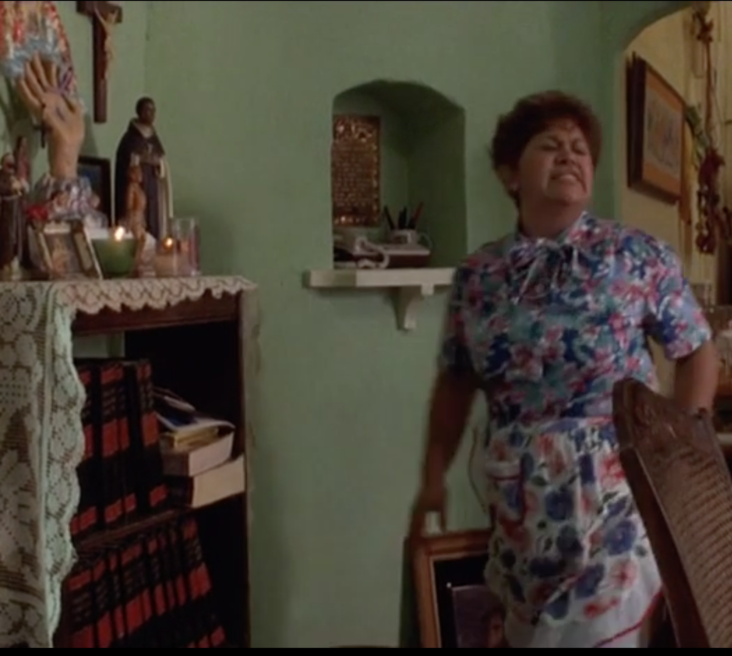
The Beginning
From the very opening scene Noriega makes some very interesting observations.
“Thus the home, with its fence, well-kept yard, and a tree, becomes the defining unit for the barrio, rather than – as in Colors(1998) et al – a montage of graffiti, gangs, drug deals and so on that signifies “problem space.”
He also has a lot to say about this picture in the first scene with Rudy and his mom.

Slide 7
“... below, the encyclopedias represent the immigrant’s rite of purchase into the objective knowledge of American society; while above, the altar with lit velas is an active and personal engagement of spiritual belief ... (which) establishes a hierarchical conflict between mother and son that works on a number of levels: gender, generation, class, and culture of origin.”
-Noriega (page 193)

Slide 8
THE REDHEADED WOMAN (6:00)
The French woman standing between the two flags symbolizes the border
“Thus the French woman negotiates a complex relationship between Mexico and the United States, on that calls into question the symbolic purity of the Statue of Liberty in identifying the United States as a nation of immigrants.”
“Passing beneath the Statue of Liberty against the backdrop of the mural, then, presages Rudy’s deportation, and precludes his return within the usual terms of immigration and assimilation.”

Slide 9
The middle (45:30, 47:00)
To make money Rudy trains OTM’s how to act like Chicanos for when they make it to America
Illustrates more of the racism of US Border Patrol
Dual irony of the OTM’s
Teaching people to act like others
Rudy learns about the true struggle of immigrants, that he was not respectful of in the beginning.

Slide 10
The End ( 1:17:30, 1:20:05)
“The scene visualizes Anglo-Americans’ worst fear about illegal aliens swarming across the border to take away jobs, drain welfare funds, overburden social services, and increase urban crime.”
Marin contrasts this belief by having them all end up directly in the barrio, skipping the white suburbs that lie between East LA and the border.
The Happy Ending
Rudy makes it home
The OTM’s pass for Chicanos as far as the white man (the police officer) is concerned
Rudy overcomes the desire for the Red Haired woman (whore), to be with Dolores (Madonna)

Slide 11
Who Is Dayani Crystal
In the documentary Who is Dayani Crystal, Mexican actor and activist Gael Garcia Bernal retraces the steps of a migrant from Honduras who mysteriously died on his long journey to America.
Much more realistic and depressing view of the US-Mexico border and the stories and politics that surround it.
Stark Contrast to Marin’s Born in East LA.

Slide 12
Direct Contrasts : Crossing the Border
Crossing the border is by far the most dangerous stint of the journey to America
(LA: 32:05, 40:15; WIDC: 2:00)
Number of people who die crossing the border has exponentially increased since the Clinton administration in the early 2000’s
Dramatic increase in number of border workers and decrease in crossers, but still huge increase in death tolls.
Why?

Slide 13
The Main Idea
As it gets harder to cross, migrants must try exceedingly dangerous routes.
23:00-24:00, 57:00

Slide 14
Look inside a migrants journey
The movie’s main actor Bernal takes all the steps “Dayani Cristal” took to get to America
Dangers
The journey begins with a ride on top of a train through all of central Mexico
Cross a river on some makeshift rafts
Jump the fence, and make it through the desert
Also contend with ”coyotes” and kidnappers
The journey is full of hope and friendship

Slide 15
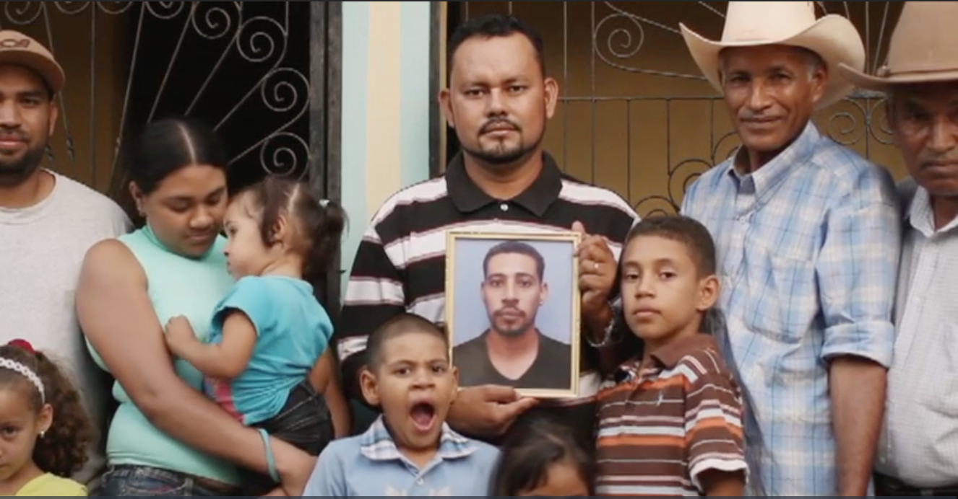
The Story of Dilcy Yohan Sandres-Martinez
To conclude the documentary, we hear the story of Yohan’s final days (1:10)

Slide 16
Questions
What are your thoughts on Noriega’s critique of Born in East LA?
What are your thoughts on the border controversies, and the idea that something will change in Washington at some number of deaths?
Schwed’s big question!

