Slide 1
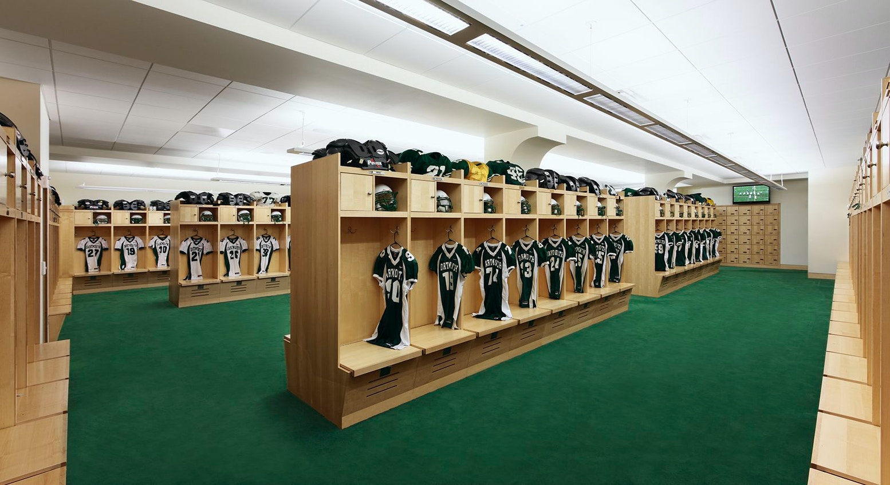
Football Locker Room Traditions
Collected By: Zack Bair, Cameron Baller, Donny Carty, Jake Guidone, Evan Hecimovich, and Jonathan Hu
Russian 13 Fall 2021

Slide 2
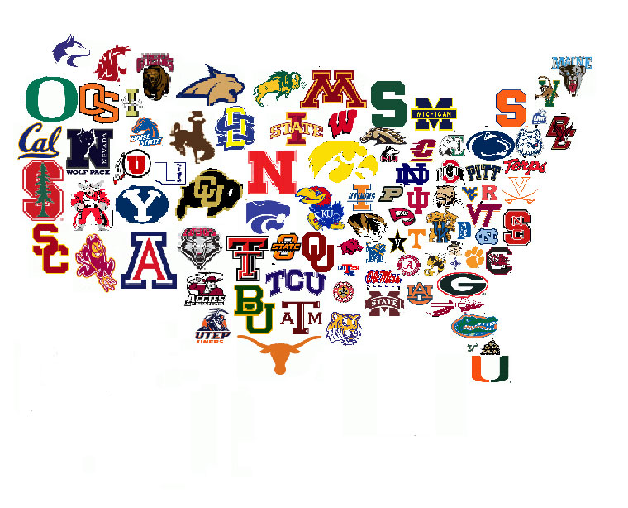
Collection Process
We collected:
30 total football locker room traditions
By interviewing 30 current and former football players
Aged 18 to 37 years old
From a variety of schools across the country

Slide 3
Interview Questions
Name, age, and gender?
Where were you born, raised, and where are you currently living?
Tell me a bit about yourself specifically as it pertains to football.
Did you have any locker room traditions when you played college football?
When and where did this tradition take place?
What do you think the meaning behind the tradition is?

Slide 4
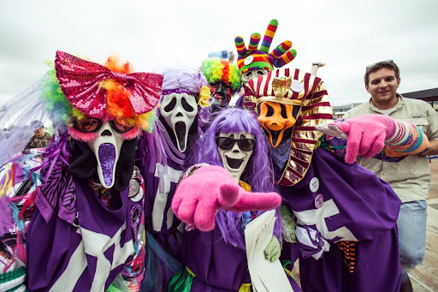
Highlighted Tradition
Location: Tarleton State University in Stephenville, Texas
R.R. played football at Tarleton State from 2005-2006
A secret group called the Purple Poos would hide an object in the locker room after a win and the team would search for the object
The player who found it would get to hold onto the object until they play the same team the following year
The object differed depending on the opponent
“If you find it, it's a special keepsake”
“The conference is deep rooted in rivalry”

Slide 5
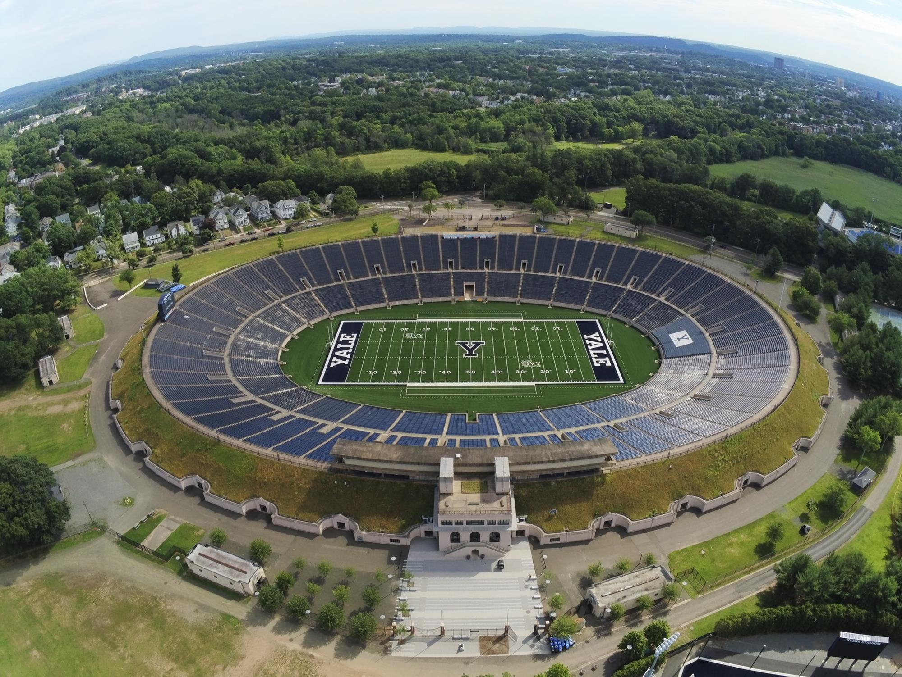
Highlighted Tradition
Location: Yale University in New Haven, Connecticut
C.S. is a senior on the Yale University football team
Team tradition that the captain of the team along with another player that is chosen by the head coach that did something special in terms of play on the field or effort stay behind after practice or a game to clean the locker room.
Tradition stems from the New Zealand rugby team, the All Blacks.
“Seen as the highest honor to be able to clean for the team which is why the captain also does it everyday.”
“It’s an honor in the sense that it is selfless and puts the team before you.”

Slide 6
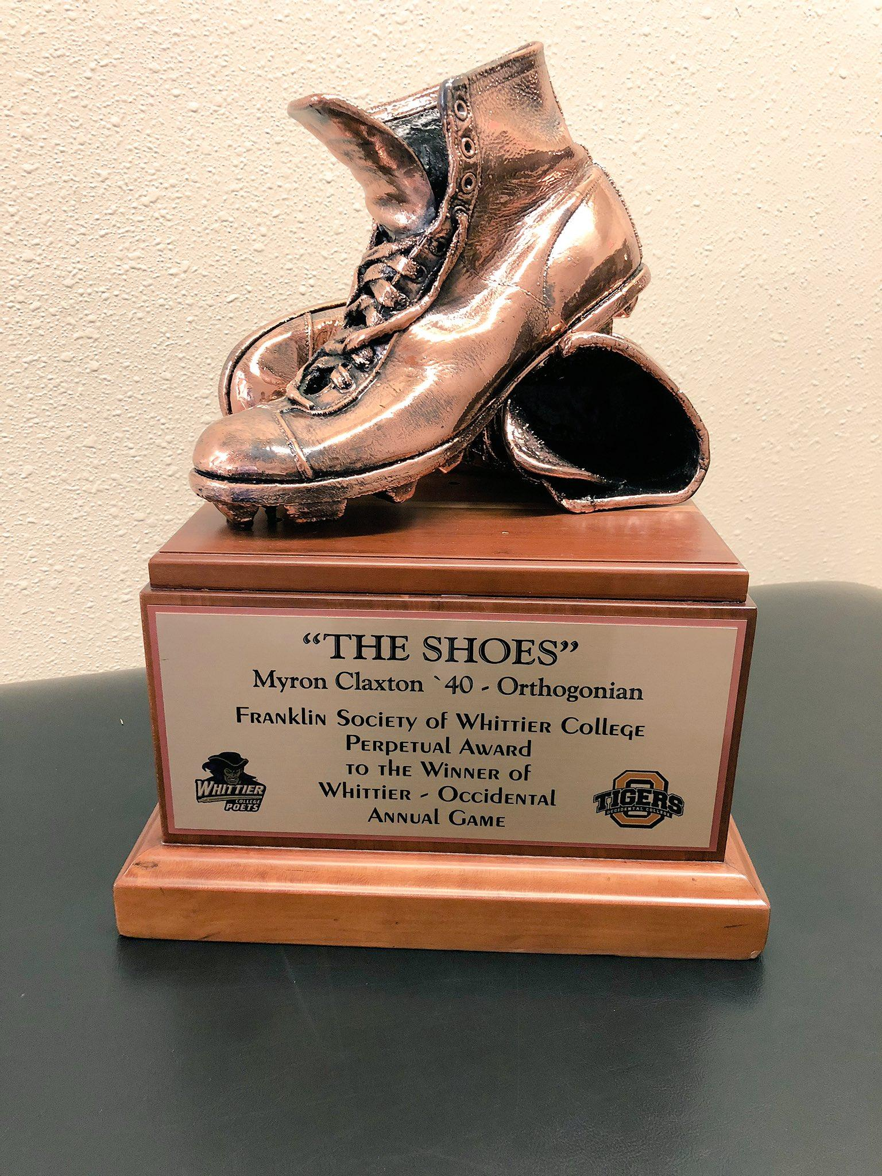
Highlighted Tradition
Location: Occidental College in Los Angeles, California
W.B. played Division 3 football at Occidental from 2017-2021
“Battle of the Shoes” rivalry with Whittier College originated in 1939 when Occidental players stole Whittier’s All- American running back’s cleats before the game, forcing him to play in his work boots. The cleats were later bronzed and turned into a trophy.
In the week leading up to this game, seniors on the team steal shoes from freshmen lockers, blaming it on a ghost named “Hector”, the man who supposedly stole Claxton’s shoes in 1939.
At the end of the week, an Occidental football alumnus shows up in the locker room dressed in pads, claiming to be Hector. He gives the team a speech reminding them of the history of this rivalry and motivating them to perform.

Slide 7
Highlighted Tradition
Location: Yale University in New Haven, Connecticut
J.D. is the current captain of the Yale football team, beginning his season in 2017 and ending this 2021.
“Senior Spotlight” is a tradition that involves the entire team. Once a week, on the night before every game, a random senior is chosen to speak in front of the team. The speech is around 20-30 minutes. They talk about “their experience with school, the team, and/or their life. It is meant to be an open conversation.”
The significance of this tradition lies in the unity of the team. It gives everyone a senior’s point of view of what they went through. It also helps the young players, bringing them closer to the team as a whole.

Slide 8
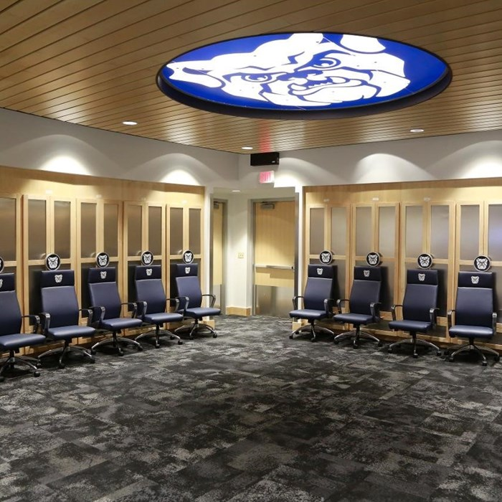
Highlighted Tradition
Location: Butler University
E.W Played Football at Butler from 2017-2020
The upperclassmen would tell the Freshman they were going to run sprints early in the morning. As a rite of passage, the Freshman had to go to the locker room and put on all their pads and gear. Everyone would line up to begin the sprints, and as they began, the upperclassmen would fall behind and leave the field. The Freshman would continue running downfield for up to 100 yards before realizing it was all a joke.
Serves as a rite of initiation that every upperclassmen had gone through at one point. Enables bonding through shared experiences and humor.

Slide 9
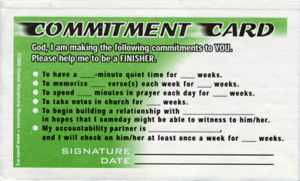
Highlighted Tradition (Jonathan)
Informant: Michael F.
Location: All Saints Episcopal School (Fort Worth, TX)
Item: Commitment Cards
Michael was exposed to traditions in his high school football program at All Saints Episcopal. As an Episcopal educational institution, All Saints promotes the Anglican-Christian tradition of worship and seeks to foster holistic student-athletes with an emphasis on religion.
In the locker room, every individual on Michael’s football team would have to create a “commitment card” and speak in front of everyone else about their commitment to the game and each other. This commitment card would then be passed to another player on the team, whose job it was to keep the originator accountable for their actions, both on and off the field. These cards embodied the school’s values of righteous action and positive reinforcement, and were intended to guide players in becoming great athletes and pillars of their respective communities. This is similar to rites of transition because of the emphasis on a transformative process – becoming a
better person through a time of learning and growth.

Slide 10
Dartmouth Football Locker Room Tradition

Slide 12
Dartmouth Medley Lyrics
As the Backs go tearing by,
On their way to do or die,
Many sighs and many cheers,
Mingle with the Harvard tears,
As the Backs go tearing by.
Making gain on steady gain,
Echo swells the sweet refrain.
Dartmouth’s going to win today!
Bet your ass we’ll win today,
As the Backs go tearing by!
Glory to Dartmouth,
Loyal, we sing.
Now, all together,
MAKE THE ECHOES RING FOR DARTMOUTH!
Our team’s a winner,
We’ve got the stuff!
We wear the Dartmouth Green
And that’s enough!
DARTMOUTH, DARTMOUTH, GREEN!

Slide 13
Common Themes Across Traditions
Invoking school pride
Foster comradery
Give honor to a higher power
Provide motivation to compete
Taking ownership of the locker room
Initiation into the team
Good samaritanship outside the locker room and football

Slide 14
Thanks for listening!
Questions?

