Slide 1
Superstitions
By,
Currie, Gabby, and Lotti

Slide 2
What is our idea?
Who are we?
Our idea: Look into superstitions amongst Ivy League Women’s Hockey Teams
Notes:
Given the members of our group consist of three Dartmouth women’s ice hockey players, we thought it would be very interesting to learn about how folklore is both similar and different amongst our main competitors, other Ivy League women’s ice hockey teams. Dartmouth in particular has many rituals and superstitions that occur before games, developing over time and continuing on each year, being passed down from players to players. We wanted to see if women’s hockey itself had consistent superstitions amongst teams and individual players and take a closer look into each member’s game day routines from the 2021-2022 teams.

Slide 3
What are superstitions as we define them?
Sign superstitions (sign and result)
If A then B (if you meet a hare or a priest, you will have bad luck)
Magic superstitions (cause and result)
If you do A then B (if you break a mirror, you will have bad luck)
Conversion superstitions
If A then B unless C (if you say that something good will happen, it will not happen, unless you knock on wood)
Notes:
Just to go over - this is how we have defined superstitions in the class

Slide 4
Methodology
How many people were interviewed: 6
How did we interview: Facetime with follow up text messages
Age ranges: 2025-2022 graduation years
Focused on pre-competition superstitions
Forms of Folklore collected: customary and material
Notes:
We tried to get a range of perspectives for each team and each person we talked to provided a new view on the way we view superstitions and how we interpret them - specifically among the women’s ivy league ice hockey teams.

Slide 5
Interview Questions
What is your: Name, Age, Gender
Where were/are you: Born, Raised, Living
What year are you graduating college?
Walk us through your typical pre game schedule.
Do you have any individual superstitions?
Please include when these superstitions started or if you created them or if they were passed down.
Does your team have any collective superstitions?
Please include when these superstitions started or if you created them or if they were passed down.

Slide 6
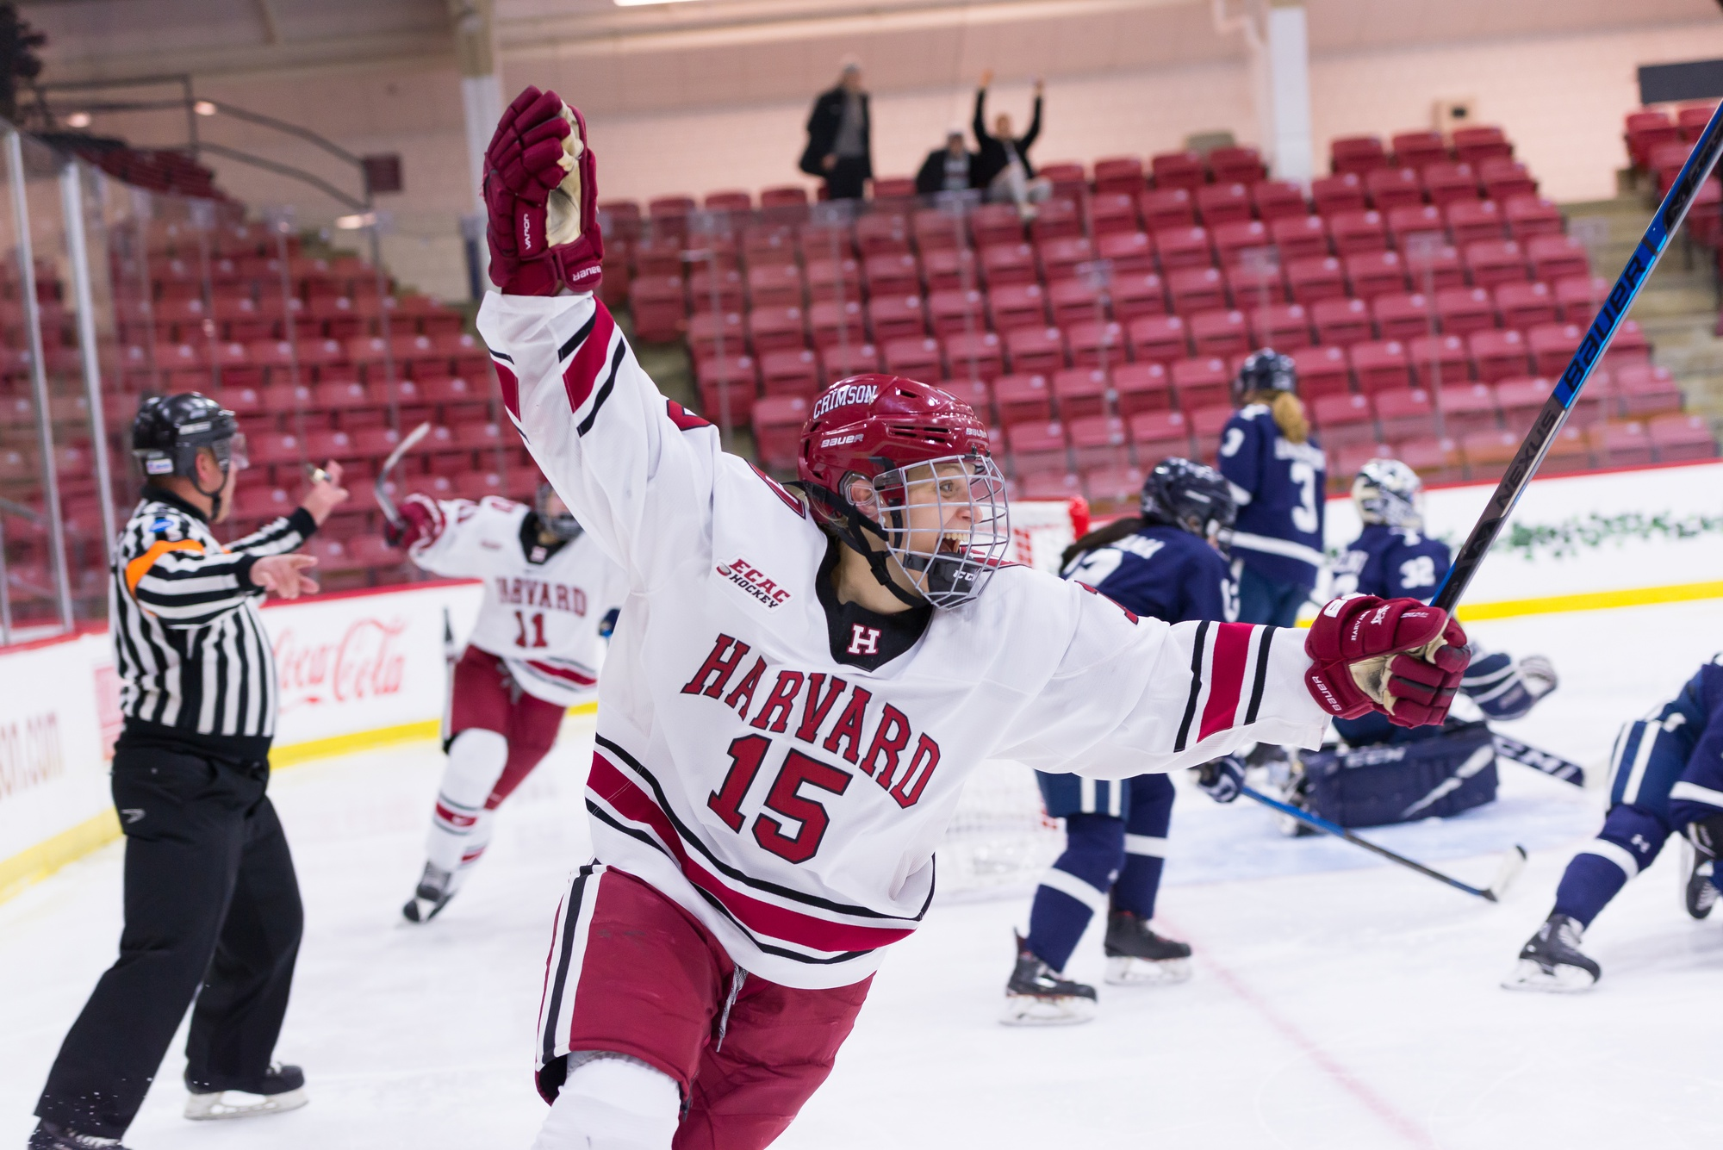
Harvard
Informant: Kyra Willoughby
Age: 22
Year: 2023
Location: Cambridge, MA
Date Collected: 11/05/21
Type of Folklore: Customary
Genre: Magic Superstition
Significance:
“There are two handshakes that must be performed during every warmup and they are passed down by graduating seniors every year. The creator is unknown, and these traditions are at least 10 years old to my knowledge.”
“Our team has a dance to Whitney Houston’s “I Wanna Dance with Somebody. This dates back to 1990, and the creator is unknown. One person dances to the song (this position is passed down by graduating seniors), while the rest of the team cheers and snaps or claps along. As a freshman, each player picks their seat in our home rink and has to sit there for the next 4 years of the performance. If someone is sitting in the wrong spot, the performance feels off and we don’t feel properly prepared for the game.”
Notes:
Kyra doesn’t have many individual superstitions because she has actively tried to get rid of them. In the past, she became too fixated on her superstitions and if anything went wrong she was convinced she would play poorly and could not properly prepare for games.
Her team does however have some superstitions that they follow…
Magic Superstition… if the team doesn’t do A… then B (they will play bad) will happen

Slide 7
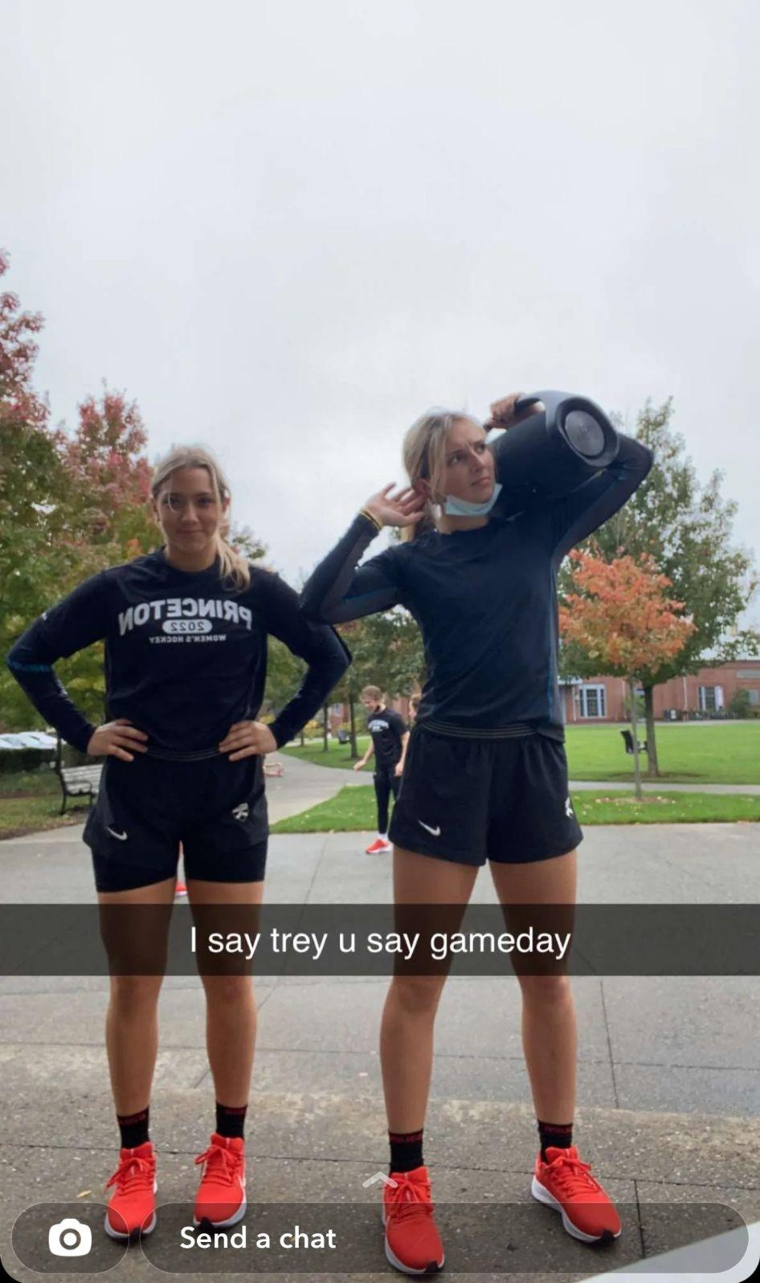
Princeton
Informant: Annie Kuehl Age: 20
Year: 2024
Location: Princeton, NJ
Date Collected: 11/10/21
Type of Folklore: Customary
Genre: Sign and Magic Superstitions
Significance:
“If CVS is out of Celcius Green Tea Lemonade then I will go to Starbucks and get a Venti Iced Vanilla latte. I tape all 3 of my sticks before our team warm ups. ‘I once broke my stick and had to use my backup, which had the worst tape job of my life, so ever since then I’ve starting taping all 3,’”

Slide 8
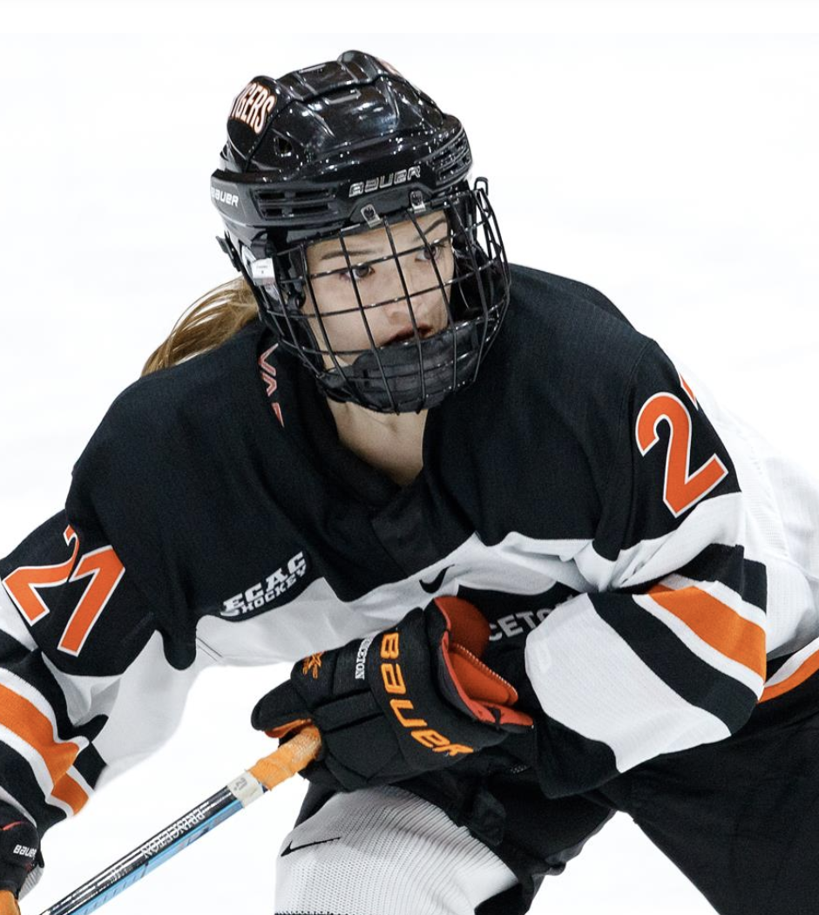
Princeton
Informant: Emma Kee
Age: 21
Year: 2024
Location: Princeton, NJ
Date Collected: 11/16/21
Type of Folklore: Customary
Genre: Magic Superstitions
Significance:
“My older brother used to tie his skates before he put on his shin pads after seeing one of his teammates do it, and I always looked up to him growing up. Now I do as well, and my sister and I both follow his lead before our games, creating our own family superstition in order to play well.”

Slide 9
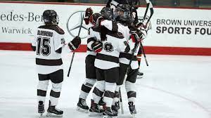
Brown
Informant: Megan Forrest
Age: 22
Year: 2022
Location: Providence, RI
Date Collected: 11/08/21
Type of Folklore: Customary
Genre: Magic Superstition
Significance:
“I leave 2 hours and 45 minutes before the game to get a caramel swirl iced coffee from Dunkin Donuts. Then I head to the rink. I sit in the stands in seat 13 in the top row of the red chairs and walk through our systems in my head while listening to a pump up playlist I have. At this point I’ll be finishing my coffee so I head downstairs and throw it out in a specific trash can by the stairs.”
“As a team, we always do the same cheer after off ice warm up and a different one in the locker room before going on the ice for the first period. We also have one girl announce our starting lineup in a fun and creative way”
Notes:
Megan has a couple very specific superstitions that she follows before her games. If she doesn’t sit in her specific seat, and throw away her coffee in the same trash can, something feels off and she is worried she won’t perform well.
TEAM cheer and lineup: Meg doesn’t know how long this dates back but she knows it has been done in the past and the creator is unknown.

Slide 10
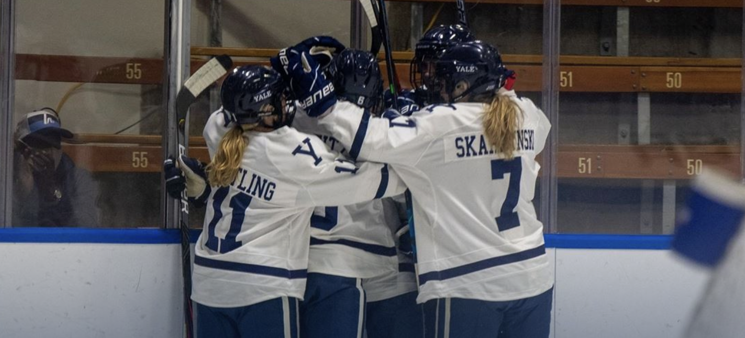
Yale
Informant: Addie Burton Age: 19
Year: 2024
Location: New Haven, CT
Date Collected: 11/08/21
Type of Folklore: Customary
Genre: Magic Superstitions
Significance:
“I re-tape my hockey stick and put the blade in the air so it does not touch the ground until game time, and when I get dressed I put my right skate on before my left.”

Slide 11
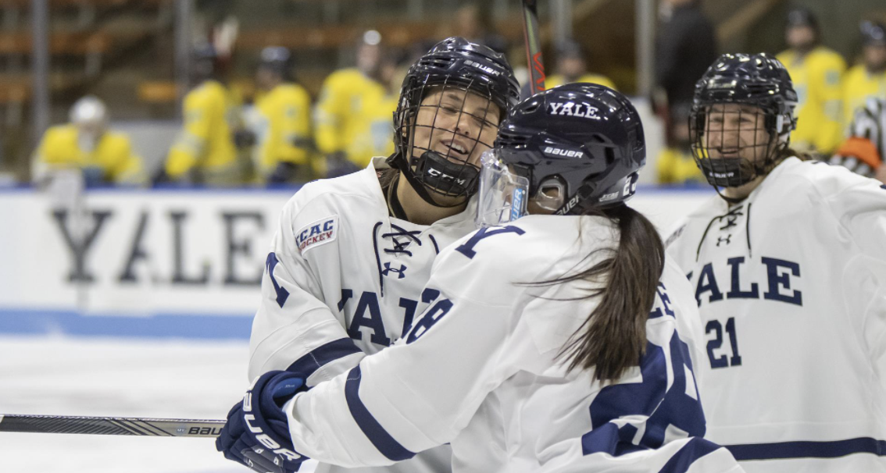
Yale
Informant: Grace Lee Age: 21
Year: 2023
Location: New Haven, CT
Date Collected: 11/15/21
Type of Folklore: Customary
Genre: Magic Superstitions
Significance:
“My coach calls each line into the hallway for a line meeting before each game, encouraging us to work together and we do a small cheer to bring up our energy levels. This allows us to feel motivated and have a positive attitude while working on communication.”

Slide 12
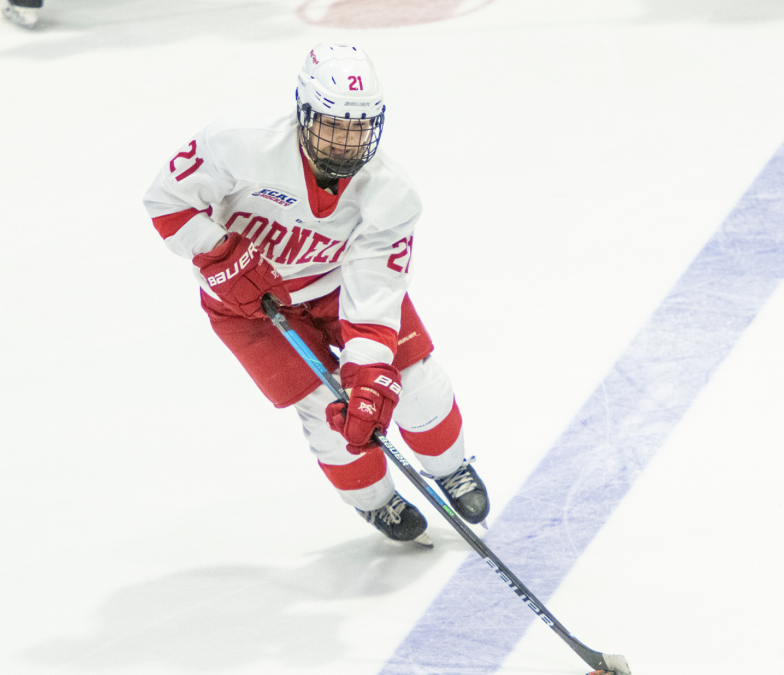
Cornell
Informant: Lily Delianedis Age: 20
Year: 2025
Location: Ithaca, NY
Date Collected: 11/09/21
Type of Folklore: Customary
Genre: Magic Superstitions
Significance:
“I have to drive to a coffee shop and get a hot chocolate, then drive around and listen to music. When we have our team warm ups I have to tap a certain wall during warmups, and do a specific handshake with one of my teammates. I have to tape my stick before our team warm ups and tap our team sign in the locker room with my stick on the way out to the ice before the first period. If I do not do these things then I will feel off and I will not have a good game.”

Slide 13
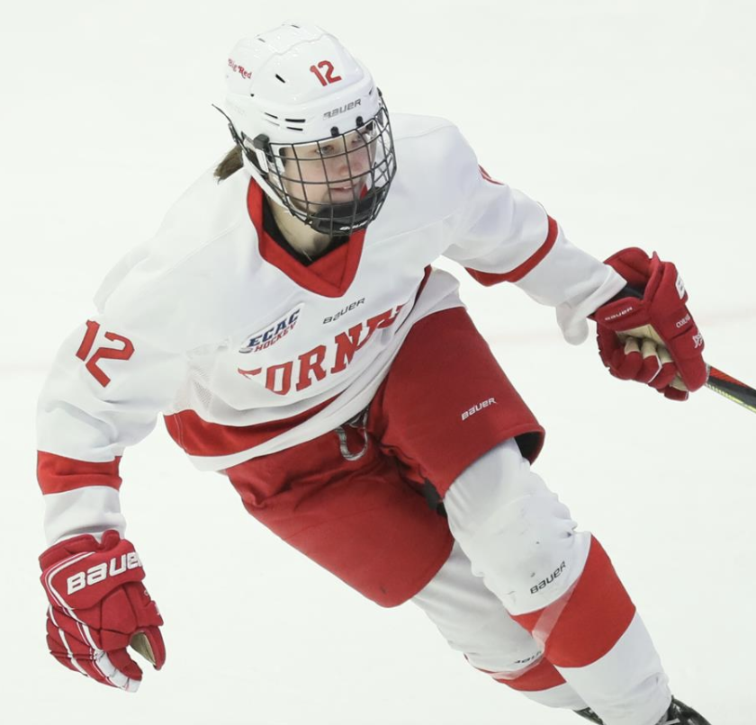
Cornell
Informant: Izzy Daniels Age: 21
Year: 2024
Location: Ithaca, NY
Date Collected: 11/15/21
Type of Folklore: Customary
Genre: Magic Superstitions
Significance:
“Every other year three seniors hand down special bracelets to three juniors on the team. I received one this year along with my three closest friends and we have to wear them for each game or we will not play well. This has been going on for as long as I can remember.”

Slide 14
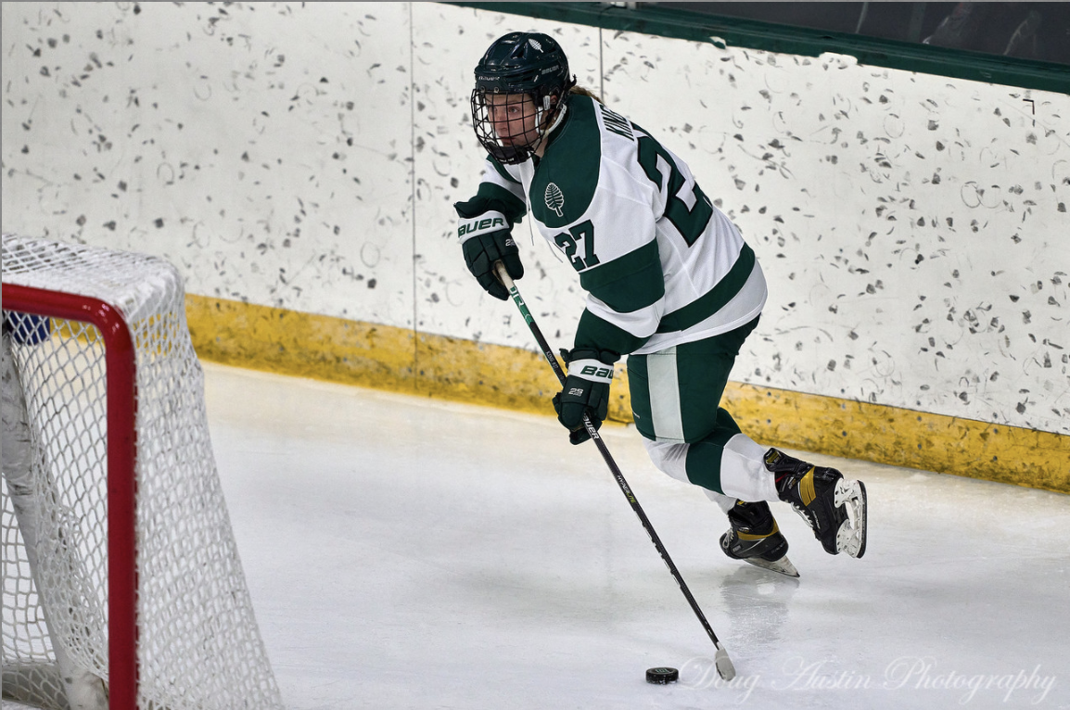
Dartmouth
Informant: Annie King Age: 19
Year: 2024
Location: Hanover, NH
Date Collected: 11/06/21
Type of Folklore: Customary
Genre: Magic Superstitions
Significance:
“Always have to wear purple under armour sports bra under my gear. If I don’t have gatorade before warm ups I will have an off game, and I drink the gatorade in specific ¼ increments so ¼ before warm ups, ¼ before the first period, ¼ before the second period, and ¼ before the third period. My sister passed these down to me and her friends before her.”

Slide 15
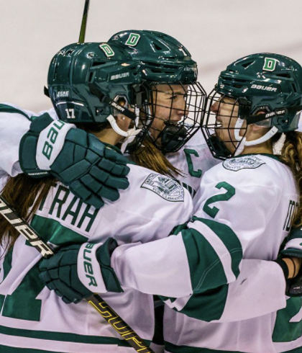
Dartmouth
Informant: Currie Putrah Age: 20
Year: 2023
Location: Hanover, NH
Date Collected: 11/15/21
Type of Folklore: Customary
Genre: Magic Superstition
Significance:
“I always have to put on my gear in a very specific order. I put on my left sock, then my right, followed by my left skate, then my right. After that I put on my hockey pants and my left shin pad, followed by my right shin pad. This trend continues on with putting my left gear on before the right until I am fully dressed.

Slide 16
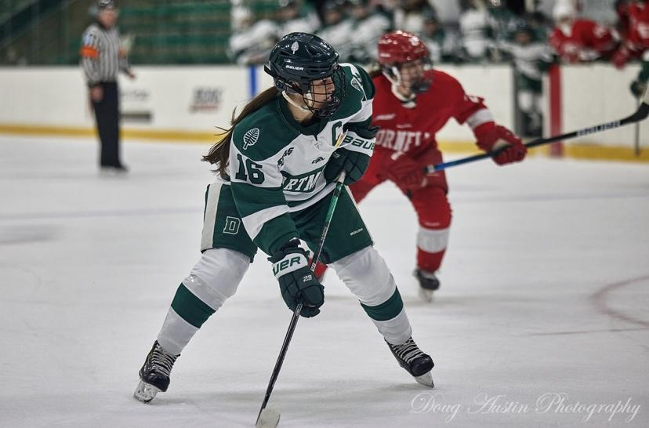
Dartmouth
Informant: Gabby Billing Age: 22
Year: 2022
Location: Hanover, NH
Date Collected: 11/14/21
Type of Folklore: Customary
Genre: Magic Superstitions
Significance:
“I always have to put on my gear in a very specific order. I put on my left sock, then my right, followed by my left skate, then my right. After that I put on my hockey pants and my left shin pad, followed by my right shin pad. This trend continues on with putting my left gear on before the right until I am fully dressed. If I do not put on my gear in this specific order I feel like my pads are not on correctly which in turn makes me think I will have bad luck during the game and play poorly.”

Slide 17
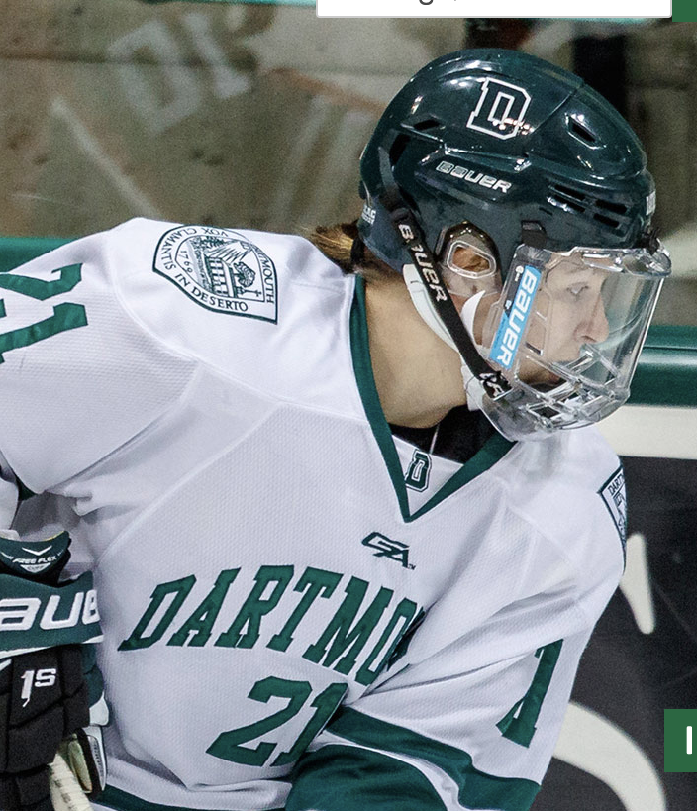
Dartmouth
Informant: Lotti Odnoga Age: 22
Year: 2022
Location: Hanover, NH
Date Collected: 11/16/21
Type of Folklore: Customary
Genre: Magic Superstitions
Significance:
“ I have to listen to the same three song before every game to get dialed in. If I don’t listen to them my thoughts are all over the place and I can’t focus in the game and therefore my performance will be bad. When I am getting dressed I have to tie my left skates before my right and then I have to step on the ice with my left foot first. A tradition that was passed down to me from previous DWIH player is that before we step on the ice for the first time in a game I have to ring the bell.I am not sure when this tradition started, but I am pretty sure it has been more than 10 years. This superstition sends the team on the ice with good luck and to have a great game.

Slide 18
Similarities and Differences
Similarities:
Mainly magic superstitions
Team chants passed down each year
Differences:
Individual superstitions

Slide 19
Conclusion/Main Observations
Main takeaways
Who are the folk? Everyone is the folk
Superstitions - typically a result of a specific event or passed down

Slide 20
THANK YOU - QUESTIONS?

