Slide 1
Folklore of Firefighters
Ryan Blankemeier, Albie Austin, Sam Wilson, Ben Martin
Notes:
ALBIE

Slide 2
Topic
Purpose: We explored the different stories and experiences of the members from the Hanover Fire Department and various other fire departments in the United States.
We want to explore and examine the folklore that has developed at the firehouse during the times when there are no emergencies to respond to.
Notes:
ALBIE

Slide 3
Methods
Informants:
Hanover FD: Michael Gilbert (Captain, age 50), Scott Letson (Lieutenant, age 35), Jeremiah Linehan (Firefighter, age 45), and Joe Amato (Firefighter, age 27)
Madison, CT FD: Anonymous (Volunteer, age 22)
Garden City, NY FD: Cody George (Volunteer, age 24)
Interviews: We conducted an in-person interview at the Hanover Fire Department with four members of their crew: Michael Gilbert, Scott Letson, Jeremiah Linehan, and Joe Amato. We also conducted phone interviews with a member of the Garden City Fire Department and a member of the Madison, CT Fire Department.
Data/Results: Along with recording the interviews, we took our own notes to capture not only what the informants were telling us, but how they were telling us.
Notes:
SAM

Slide 4
Results
The data that we gathered from the firefighters fell into the following categories: superstitions, sayings, jokes/pranks, and rituals. Many of these categories deal with magic which makes sense in an occupation as extreme and unpredictable as firefighting.
Although the firefighters have many superstitions, they also spend many hours precariously preparing and mastering their craft.
“If you were to suggest to a native that he should make his garden mainly by magic and scamp his work, he would smile at your simplicity.” - Malinowski
Notes:
BEN

Slide 5
Hanover Fire Department
Notes:
BEN

Slide 6
Superstitions
Notes:
BEN

Slide 7
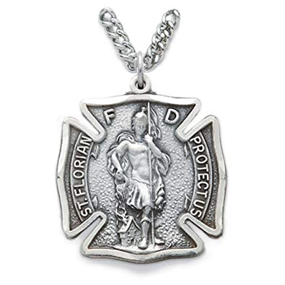
It is good luck/provides protection to wear a necklace of Saint Florian, the protector saint of firefighters.
Informant: Captain Gilbert
Wears only in the fire house
Provides added sense of protection
Law of contact
Magic Superstition
Notes:
BEN

Slide 8
Everything Runs in Threes
Informants: all 4 firefighters from Hanover FD
The firefighters believe that if they get one call, then they will inevitably receive two more.
Sign Superstition
Notes:
BEN

Slide 9
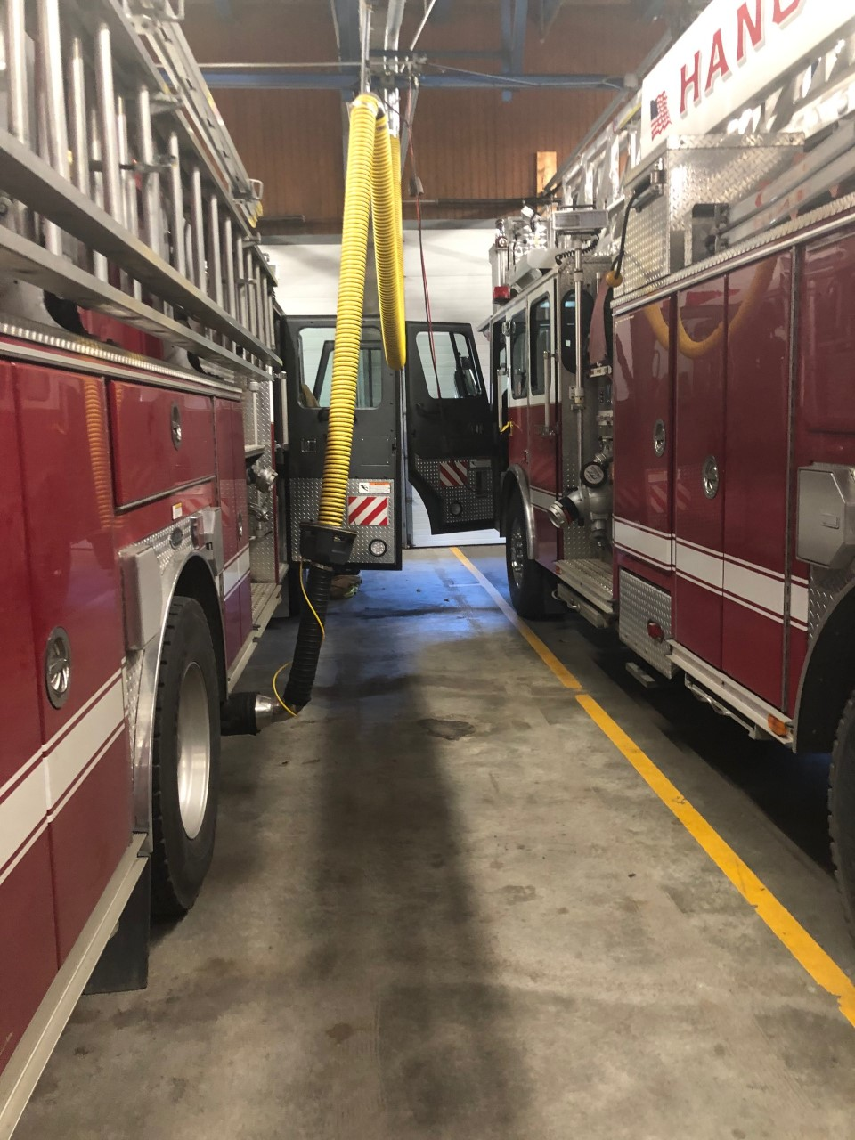
If there is an old truck that has seen a lot of fires in the station, then they are more likely to receive a call
The presence of the truck makes them more likely to catch a fire
Magic superstition
Law of similarity
Notes:
BEN

Slide 10
Individual Superstitions
Lieutenant Letson: If he wakes up before 2am to go to the bathroom, they will go out on a call the next day
Firefighter Amato: If they sit around the firehouse talking about training, they will get a call
Firefighter Linehan: If he has something important to do, they will be up all night responding to calls
Notes:
BEN

Slide 11
II. Sayings
Notes:
SAM

Slide 12
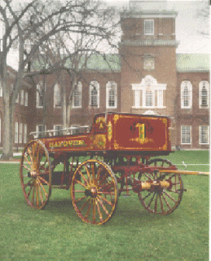
“One hundred years of tradition not impeded by progress”
Stuck in their old ways
Refusal to change
Only recently replaced their very old ambulance
Notes:
SAM

Slide 13
III. Pranks/Jokes
Notes:
ALBIE

Slide 14
If a person they helped brings in food for a specific shift, the shift on duty eats all of the food, but leaves the note every time.
Informant: Captain Gilbert
Provides some levity in a very serious/dangerous field
Pranks help them pass the time when they have down time
Notes:
ALBIE
Talk about how they leave the money too if any is left

Slide 15
If someone leaves ice cream in the freezer, they eat the ice cream and then fill the container with water
Informant: Captain Gilbert
Again, this prank provides some levity in the otherwise serious work.
Notes:
ALBIE
Sort of leaves their own myth or mystery, especially among other fire departments because it is usually unclear who did it

Slide 16
IV. Rituals
Notes:
BEN

Slide 17
Initiation Ritual
Any new member to join the Hanover Fire Department is tasked with working harder and longer hours. They are required to clean the equipment and prepare for future calls.
Rite of Incorporation into the fire department
Allows them to learn more quickly and also become well acquainted with the other firefighters
Considered “paying your dues”
Notes:
BEN

Slide 18
Garden City, NY Fire Department
Notes:
Albie

Slide 19
Rituals, Traditions and Stories
Every Monday night, different cook but same dinner
Saturday morning breakfast and training
Chef decides that day’s training exercise
New Guys and Initiation
Different from the other groups we interviewed → all pitch in and Captain will do the cleaning same as the new trainee
Story and Myth Trivia via GroupMe
Via the call logs from the Secretary
Notes:
Albie
Dinner → way for them to test who is actually the best cook in the house (certain ppl cooking means certain calls will happen similar to the Hanover FD superstitions)

Slide 20
Recording Clips
Story Sharing within Cody’s Department
Notes:
Albie
5:34 into clip

Slide 21
Madison, CT Fire Department
Notes:
SAM

Slide 22
Superstition
The informant wears a rubber bracelet every time he is inside the fire house for good luck/safety.
This magic superstition is very similar to the Saint Florian necklace from the Hanover FD.
According to the informant, many of the other firefighters in the Madison FD wear “lucky” items while they are working.
Notes:
SAM

Slide 23
Initiation Ritual
The new members in the Madison FD are required to be the first ones to arrive for their shift and the last ones to leave the firehouse after the shift. Also, they are tasked with cleaning the firehouse, the trucks, and the equipment.
Again, this is very similar to the Hanover FD, and appears to be a rite of incorporation into the department.
Notes:
SAM

Slide 24
Concluding Remarks
Most of the folklore has to do with controlling the uncontrollable (through the use of superstitions). In a field as dangerous as firefighting, this makes sense - they want to feel as safe and in control as possible due to the uncertainty surrounding their work.
Notes:
SAM

