Slide 1
International Folklore:
Evil Spirits & Superstitions
Alex Paget, Alex Leibowitz, Saif Malley, and Stas Van Genderen

Slide 2


















Scope of Project
Focus on Dartmouth International Community
Superstitions from home countries
Diversity of countries/geographies include: China, Turkey, Rwanda, Pakistan, Sweden, Greece, France, Brazil, Guinea, Germany, Oman, Kenya, Japan, India, South Africa, Colombia, Kazakhstan, & South Korea

Slide 3
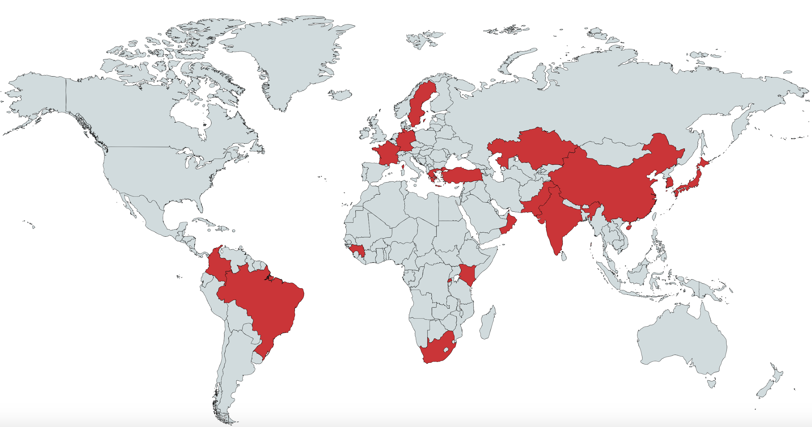

Slide 4
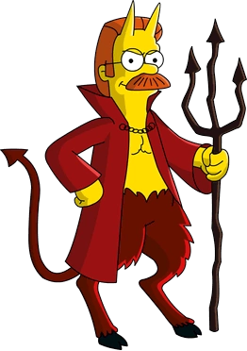
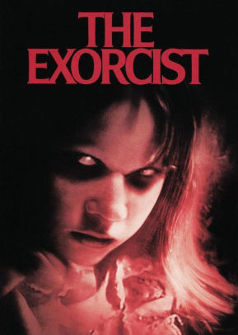
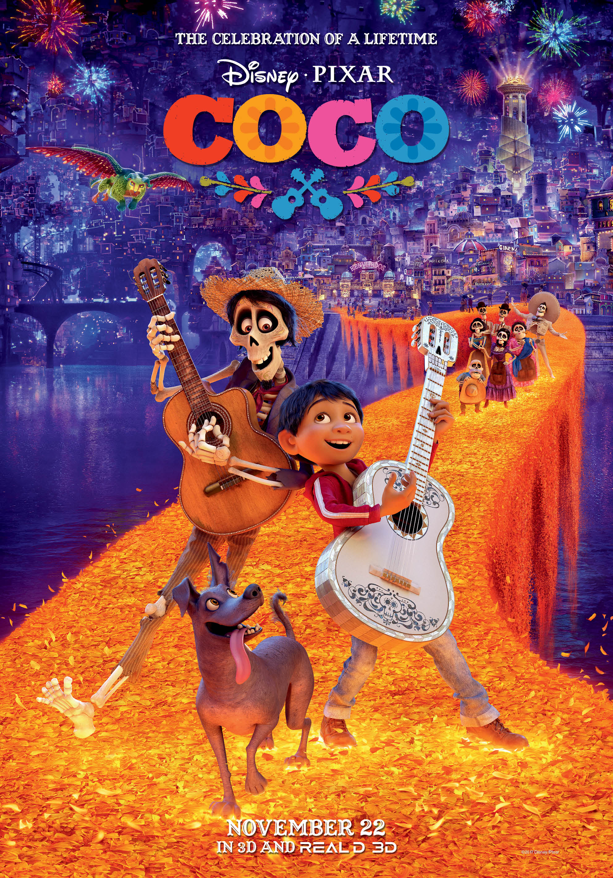
Reason for Interest: Relevancy in Culture
Evil spirits play a prominent role in the arts

Slide 5
Methodology
Assemble list of international students from diverse range of countries
Reach out to students about potential examples of evil spirit
Interview relevant students, recording and transcribing the process
Analyze the interviews to form preliminary conclusions

Slide 6
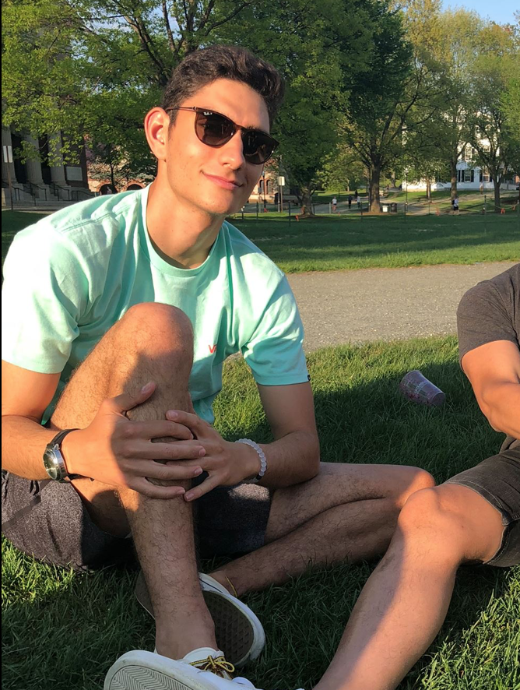
Example 1: Greek Evil Eye ‘μάτι’ (mAH - tee)
Informant Data: Andreas Louskos is a ‘21 at Dartmouth College from Athens, Greece
Contextual Data: Andreas will call his grandmother when he is feeling ‘under the weather’
Item: Encounters with an evil eye require an older member of the family, usually female, to say certain prayers in order to rid the member of the evil

Slide 7

Example 2: Turkish Evil Eye ‘nazar’
Informant Data: Bertan Gülşen is a ‘21 at Dartmouth College from Istanbul, Turkey
Contextual Data: One instance is when a person will compliment another, indicating possible envy
Item: Evil eye is bad luck brought on by someone else envying you

Slide 8
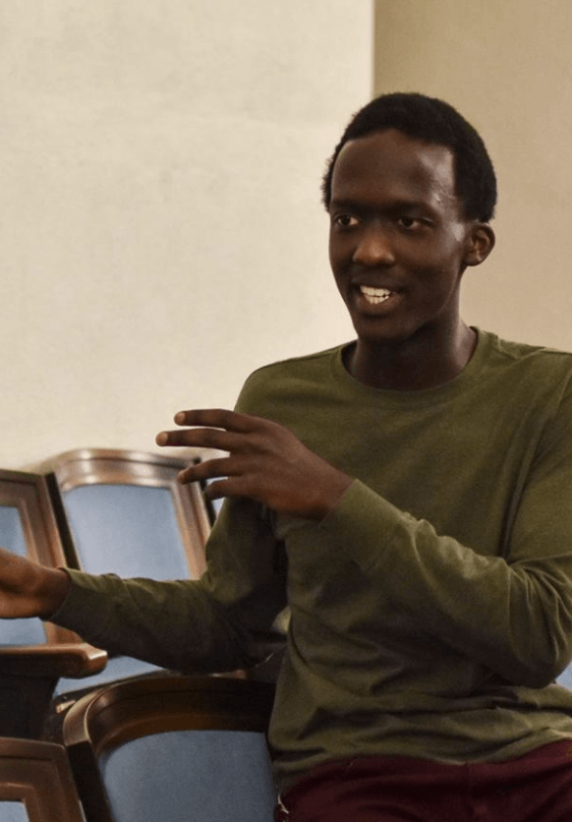
Example 3: Rwandan Evil Spirits
Informant Data: Bryan Manzi is a ‘21 at Dartmouth College from Kigali, Rwanda
Contextual Data: Naming tradition in Rwanda, designed to prevent evil spirits. Typically occurs in families with one or more deceased members
Item: People name their children after horrible things to ward off bad spirits. Examples include a person named after a termite, and a hyena.

Slide 9

Example 4: French Superstition
Informant Data: Emmanuelle Loulmet is a ‘19 at Dartmouth College from Paris, France
Contextual Data: It is necessary to look into another person’s eyes when saying “cheers”
Item: If someone does not make eye contact when saying cheers then the person is cursed with 7 years of bad sex

Slide 10
Example 5: Kenyan (Luhya) Superstition
Informant Data: Brian Muleri is a ‘21 at Dartmouth College from Nairobi, Kenya
Contextual Data: Introduction of the children of one’s current wife with the children of one’s past wife
Item: A ceremony must be performed before introducing step-children to one another, traditionally at the house of the village elders

Slide 11
Example 6: Colombian Superstition
Informant Data: Isabela Velasco is a ‘21 at Dartmouth College from Bogotá, Colombia
Contextual Data: Christmas time tradition that ensures good luck or bad luck for the year
Item: During Christmas at midnight, everyone gets a bill of the lowest denomination that is tied ensuring good luck, if the bill is untied then bad luck will follow

Slide 12

Example 7: Chinese Evil Spirits ‘年寿’ (nian shou)
Informant Data: Ray Li is a ‘20 at Dartmouth College from Beijing, China
Contextual Data: A material Mandarin character is inverted during the Lunar New Year celebrations
Item: 福 (fu), which means happiness and prosperity, is inverted so it looks like ‘nian.’ This is done to ward off the evil monster ‘lian’

Slide 13
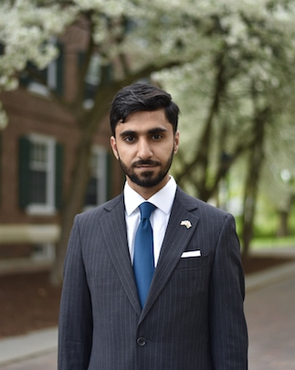
Example 8: Omani Superstition
Informant Data: Asaad Al-Raeesi is a ‘19 at Dartmouth College from Muscat, Oman
Contextual Data: Instances when the evil eye could occur and how to avoid resulting bad luck
Item: Omanis believe in the power of envy, so after any compliment one would say “Mashallah” to ward off evil

Slide 14

Example 9: Korean Evil Spirits
Informant Data: Jeeseob Jung is a ‘20 at Dartmouth College from Seoul, South Korea
Contextual Data: New Year tradition focused on honoring one’s ancestors
Item: Prayers and practices to honor one’s ancestors, where the family puts up pictures of their relatives and leave the door open so the deceased can ‘return’

Slide 15
Observations: Spirit Traditions are Familial
Kenyan tradition of step-child introduction
  Centers on integration of ‘separated’ family
Greek tradition of Evil Eye
  Tradition passed down at ceremony
  One member of the family
  Role of the grandmother and maternal influence
Chinese Evil Spirits
  The letter is hung on the door of each house, done as a family
  Maybe an example of Law of Similarity

Slide 16
Observations: Evil Spirits are still Present
Chinese Lunar New Year tradition
  Evil spirit can bring bad luck for the coming year
  Ray told us that it is a common tradition that is still practiced today
Greek Evil Eye
  Andreas still calls his grandmother when he feels the evil eye coming on him
  It is a superstition that still holds power in the modern context
Turkish Evil Eye/envy tradition
  Must be on constant guard against evil spirits

Slide 17
Preliminary Conclusions
Evil Eye superstitions help avoid the unexplainable, potentially causal relationship which seems to exists when one experiences a failure after a success
There is a mixture of both magic superstitions and conversion superstitions
Spirit traditions focus on one’s family and separate (Lunar New Year) the existing human world from the ‘other’ world
We look forward to further clarifying our thoughts as we begin to deeply analyze our extensive fieldwork

