Slide 1
The Workplace Folklore of Dartmouth Facilities, Operations, and Management
By Jacob Cruger, Rick Gangopadhyay, Harlan Smart, Ross Wood

Slide 2
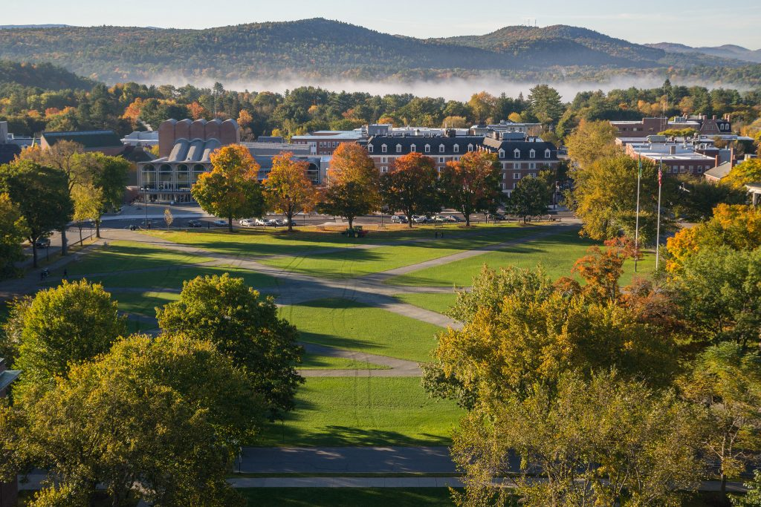
Topic
Interested in: Facilities, Operations, and Management workers at Dartmouth College
This designation includes:
- Custodial Services, Engineering Services, Hinman Mail Services, Key Desk, Trash, Recycling & Composting, Transportation Services, Campus Shuttles, and Work Control Center.
- Not all of the sectors of FO&M were interviewed for folklore.
FO&M is a conglomerate of independently-operating but interconnected offices, shops, and individual employees

Slide 3
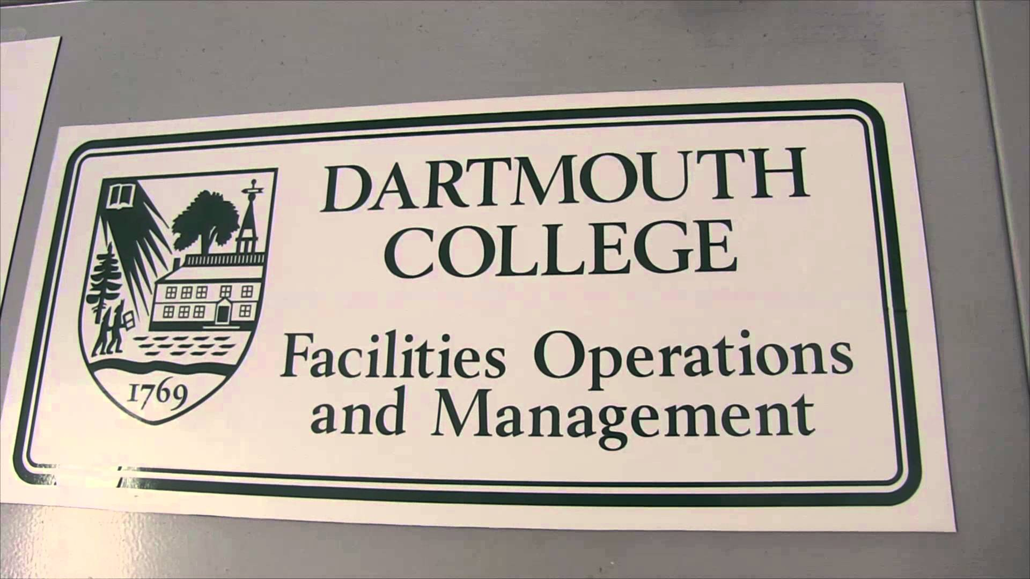
Methods
Data collected through one-on-one, in-person interviews
Interviews recorded and transcribed according to the Wilson collection procedure and Dundes’s “Context, Text, and Texture” framework
All interviewees were current Facilities, Operations, and Management and Campus Services employees

Slide 4
Folklore Item: Dorm Horse Legend
Informant Data: FO+M Locksmith, started working for the college 38 years ago. Has worked in multiple FO+M divisions. Originally from the Upper Valley, the child of a former FO+M employee.
Contextual Data: One of many stories passed to informant by older FO+M employees. Takes place “way before 1975,” between ten to twenty years before the informant started working for the college. The informant was told this story is true. The story describes an experience of a custodian assigned to an undergraduate dorm.
Item: A custodian for Wheeler hall walks into the building and hears a clomping sound coming from above him. Goes up to the fourth floor and finds a horse and buggy. Knowing horses will go up stairs but not down stairs, the custodian gathers a group to help him get the horse down the stairs.

Slide 5
Analysis: Dorm Horse Legend
Story falls within the definition of narrative folklore
More specifically, is a legend according to Bascom’s framework
- Contemporary setting
- Secular content
- Believed to be true
- Primarily about human characters
Legends about horses/cows in buildings are relatively common – perhaps the trick is a form of folklore in its own right

Slide 6
Folklore Item: Skill with 60-Foot Ladders
Informant Data: Roofing Employee who has been at Dartmouth 25+ years. He lives in Vermont with his wife. Is the last member in the Roofing Department who has not retired.
Contextual Data: Roofing takes care of patching holes, clearing snow, and hanging banners. Works on Dartmouth Hall, Mass Row, Sanborn, McNutt, Foco, and fraternities. Being comfortable on a ladder high in the air is not written anywhere but part of the job requirement.
Item: The ability to use a ladder everyday was the first piece of folklore that came to mind for the informant. The skill of handling a 60 foot ladder alone is something that is only shared amongst the Roofing Department. The informant passed on this importance of being confident on a ladder to previous roofing workers.

Slide 7
Analysis: Skill with 60-Foot Ladders
Even commonplace tools have a place in customary lore.
- Does not need to be a unique item for a folk group to turn something into lore
Although superstitions are not proven to be true, the informant was not aware of any falls or injuries from falling off a ladder during his time at Dartmouth.
- “If I don’t perform my ritual on the ladder, I’ll fall off”
- Not scientific, but perhaps gives confidence to the ladder operator while he’s at scary heights

Slide 8
Folklore Item: Hinman Window Superstition
Informant Data: Hinman Mail Services Employee. Began working for Hinman Mail Services two years ago and originates from the state of Kentucky. Has worked exclusively for Hinman as a part of the FO&M team but interacts with other sectors during each shift.
Contextual Data: Superstition is one that has been known to other Hinman employees in the past and has been confirmed by the employee himself. Speaking to other employees, he has found this to be a common occurrence of the past.
Item: When Hinman has just closed and the employee is lowering the window barrier, someone will come to the window and ask for service despite Hinman being closed if the barrier is closed too slowly. Older Hinman workers have passed on the knowledge that, to avoid this, he must always close the window swiftly.

Slide 9
Analysis: Hinman Window Superstition
This is an example of a Superstition - fits definition discussed in class.
- A traditional saying that can describe specific conditions and their consequences.
Falls under category of Magic Superstition.
- Recall: If you do A then B will happen.
- Ex. If you pour salt on the ground, then you will experience bad luck.
If you do not close the Hinman window quickly - you will have to deal with another person in line.

Slide 10
Folklore Item: Origin of Chicken Mondays
Informant Data: High level manager within DDS. Has been at Dartmouth for nearly 40 years and has worked with the areas today known as the Hop, Collis Cafe, and 53’ Commons.
Contextual Data: Tradition that started in the early 1990s during the tenure of Larry James. Started as the informant began his time in 53’ commons previously known as Thayer Dining Hall. Before the time when the “all-you-can-eat” style of dining was in place.
Item: Customary Lore, the same chicken recipe has been served on Monday for nearly 25 years. Chicken, mashed potatoes, gravy, corn, and cheese have topped the plates of Dartmouth students every Monday for nearly 3 decades. At one point was attempted to change from Monday to Wednesday, but outcry from the student population has cemented this tradition on Mondays.

Slide 11
Analysis: Origin of Chicken Mondays
Clear example of Customary Lore
- A ritual that has been practiced for a prolonged period of time
- We could call this a Dartmouth culinary rite
Fits the definition of a ritual and is a member of the customary lore section based off of the Wilson document
Has maintained a rather stable history despite attempts the change type of food, day, and time

Slide 12
Image credits
Image one: https://www.dartmouth.edu/~dartmouthdirect/2016/07/hanover-nh-ranked-in-the-top-30-college-towns-of-america/
Image two: https://campus-services.dartmouth.edu/

