Slide 1
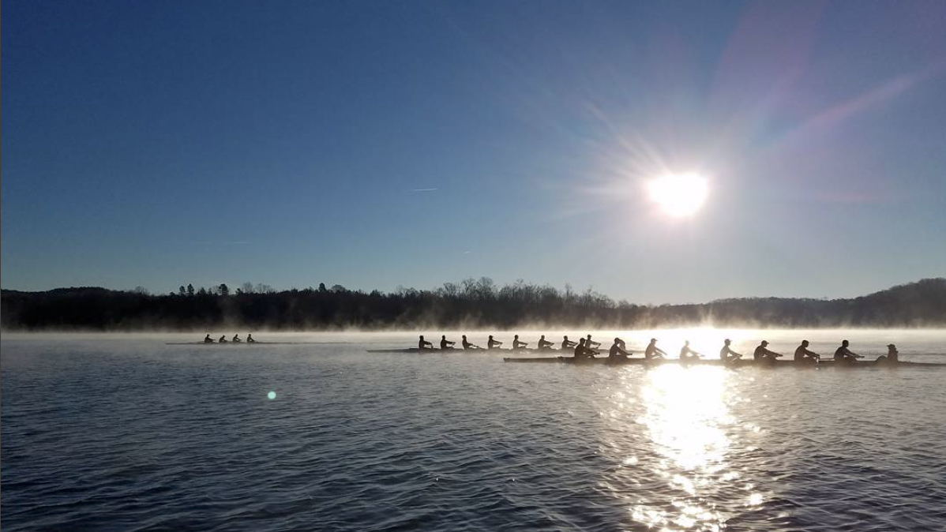
Lightweight Rowing Folklore at Dartmouth
Russian 13: Folklore Collection Project
Yeonjae Park, Sam Gochman, Brian Chekal, & David Oh

Slide 2
Overview
We collected 18 pieces of lightweight rowing folklore
Background into Lightweight Rowing
Customary Folklore
Verbal Folklore
Material Folklore
Interpretations and conclusion
Notes:
YJ

Slide 3
Background
The Dartmouth lightweight rowing team is an exclusive and cohesive group that shares their sport as a common factor. They spend a significant amount of their time together, sharing practices, workout sessions, meals, friends, fraternities. Over time and many generations of class years, the team has developed a unique series of behaviors, manifested in rituals, legends, jokes, and more.
Notes:
YJ

Slide 4
Customary Folklore
Examples
Weight cutting
Greek yogurt and cinnamon
Post-practice chant (also verbal)
Notes:
BC

Slide 5
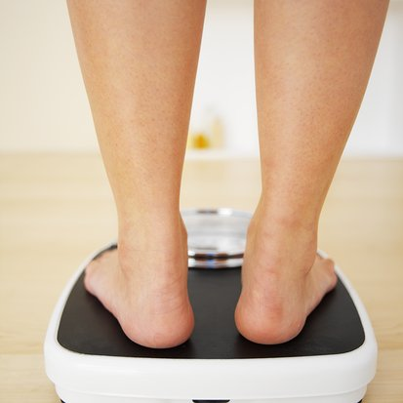
Weight Cutting Rituals
Weight cutting is a central part of being a member of the D150 folk. As such, upperclassmen make sure to pass on key weight cutting rituals and tips to freshmen.
Helps solidify team unity and identity by reinforcing a key folk-commonality.
Ex:
Cutting carbs and sodium
Spitting
Avoiding water on weigh-in day
Notes:
It seems antithetical for the athletes to have to cut weight so drastically if they are only going to gain weight again before the race even happens. The goal of weight cutting is to satisfy an arbitrary standard (expressed by informant) set by a rowing organization in order to be qualified to race, but the weight doesn’t actually impact performance. Further, athletes are weakest when cutting weight, so they feel the need to gain weight again before the race.

Slide 6
Greek Yogurt & Cinnamon Superstition
Rowers will only eat a bowl of Greek yogurt and cinnamon for dinner the Wednesdays before Friday weigh-ins
Based on the superstition that avoiding a “normal” dinner will ensure that you will “make weight” (sub-160lbs)
Reinforces a common struggle that D150 rowers face
Reinforces the common identity of this folk group
Notes:
BC

Slide 7
Post-Practice Chant
Leader: “Let’s get a ‘Green’ on 3!”
Everyone: “1, 2, 3 GREEN!”
Performed at the end of each practice
Encourages team cohesiveness and emphasis on group over individual
Reproduced with permission
Notes:
SG

Slide 8
Verbal Folklore
Examples
Lone Pine myth
Alumni legend
Jokes
Notes:
SG

Slide 9
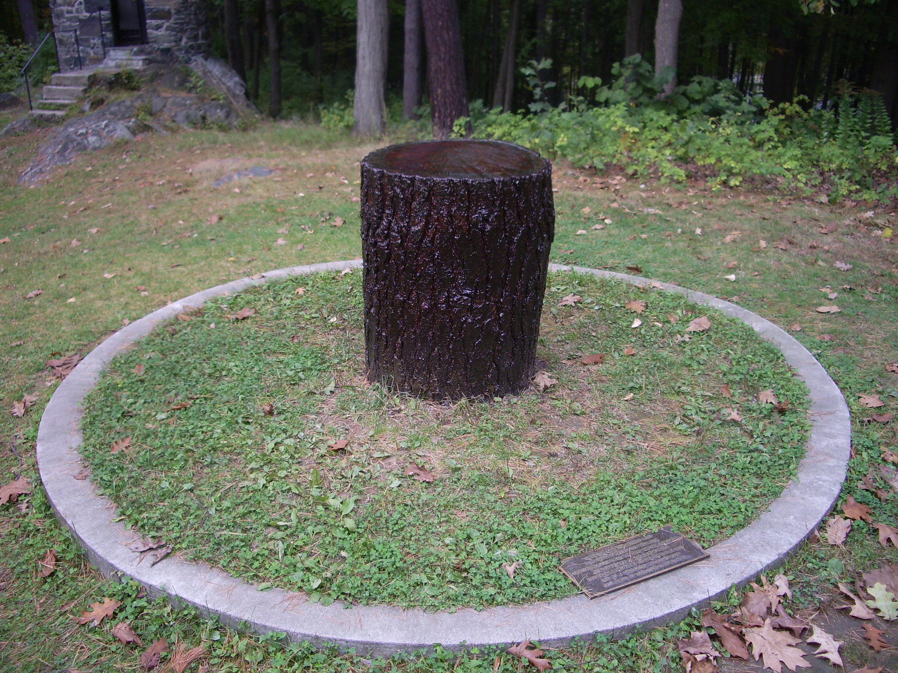
Lone Pine Myth
Dartmouth’s Lone Pine stood the test of time and survived all of the other trees in the landscape. When lightning struck the tree and split it in half, the people of Hanover wanted to cut it down and burn it. The rowing team could not let this happen, so they decided to go out with axes to cut down the tree and make a boat out of it.
Told to freshmen by upperclassmen
Connects team to Dartmouth culture, creates bonding through shared story
Notes:
SG

Slide 10
Stabbing Legend
Var 1: Against the wishes of his coach, a previous member of the team spent a day in Boston for fun, keeping this a secret. While there, he was stabbed, but still had to return to school for training. Keeping his injury a secret, he then did a test piece on the ERG and pulled off a personal record that day as his blood soaked his jersey.
Var 2: When a previous member of the team was going home one night, he was confronted by muggers and was feeling really rattled as he ran away. When he went home, his roommate noticed that he was bleeding because he got stabbed, but he didn’t realize because his adrenaline was pumping. Rather than telling his coach about his injury, he continued normally during practice, but his wound opened up and his uni became bloody.
Told by upperclassmen to underclassmen
Instills toughness and mental discipline for the new members of the team
No fixed form to story
Notes:
DO

Slide 11
Jokes
“You can’t win a race on a scale but you sure as hell can lose one.”
Joke lives on with coach throughout the years across generations of athletes
Mimicry by both new and experienced rowers
Helps bridge the gap between first joining and really becoming a part of the team
During the off season, rowers call themselves D180 if they gain weight.
Highlights significance of weight
Change of identity
Notes:
DO

Slide 12
Material Folklore: Bequests
Traditionally passed down from graduating seniors to underclassmen
Exchanged in spring after season finishes
People are connected through a common trait
Bequest links generations, creating team cohesiveness through history
Notes:
SG

Slide 13
Henley Jacket
Passed down from current captain to captain of the next year
High honor on the team
Reproduced with permission
Notes:
SG

Slide 14
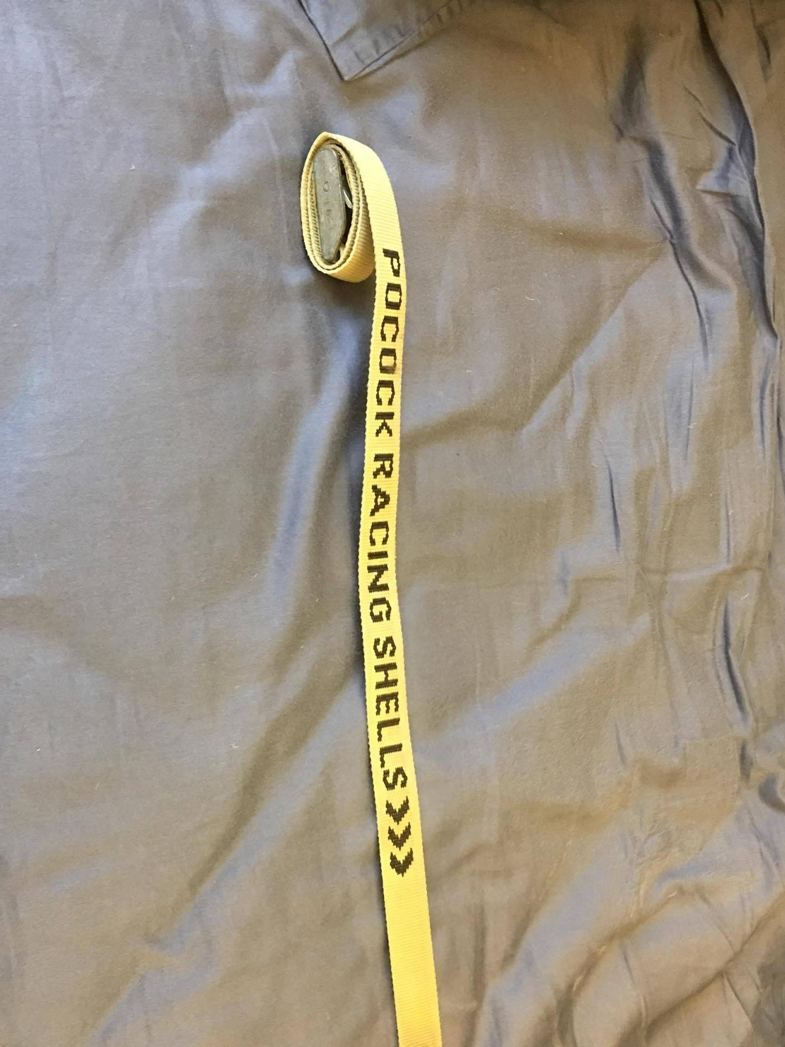
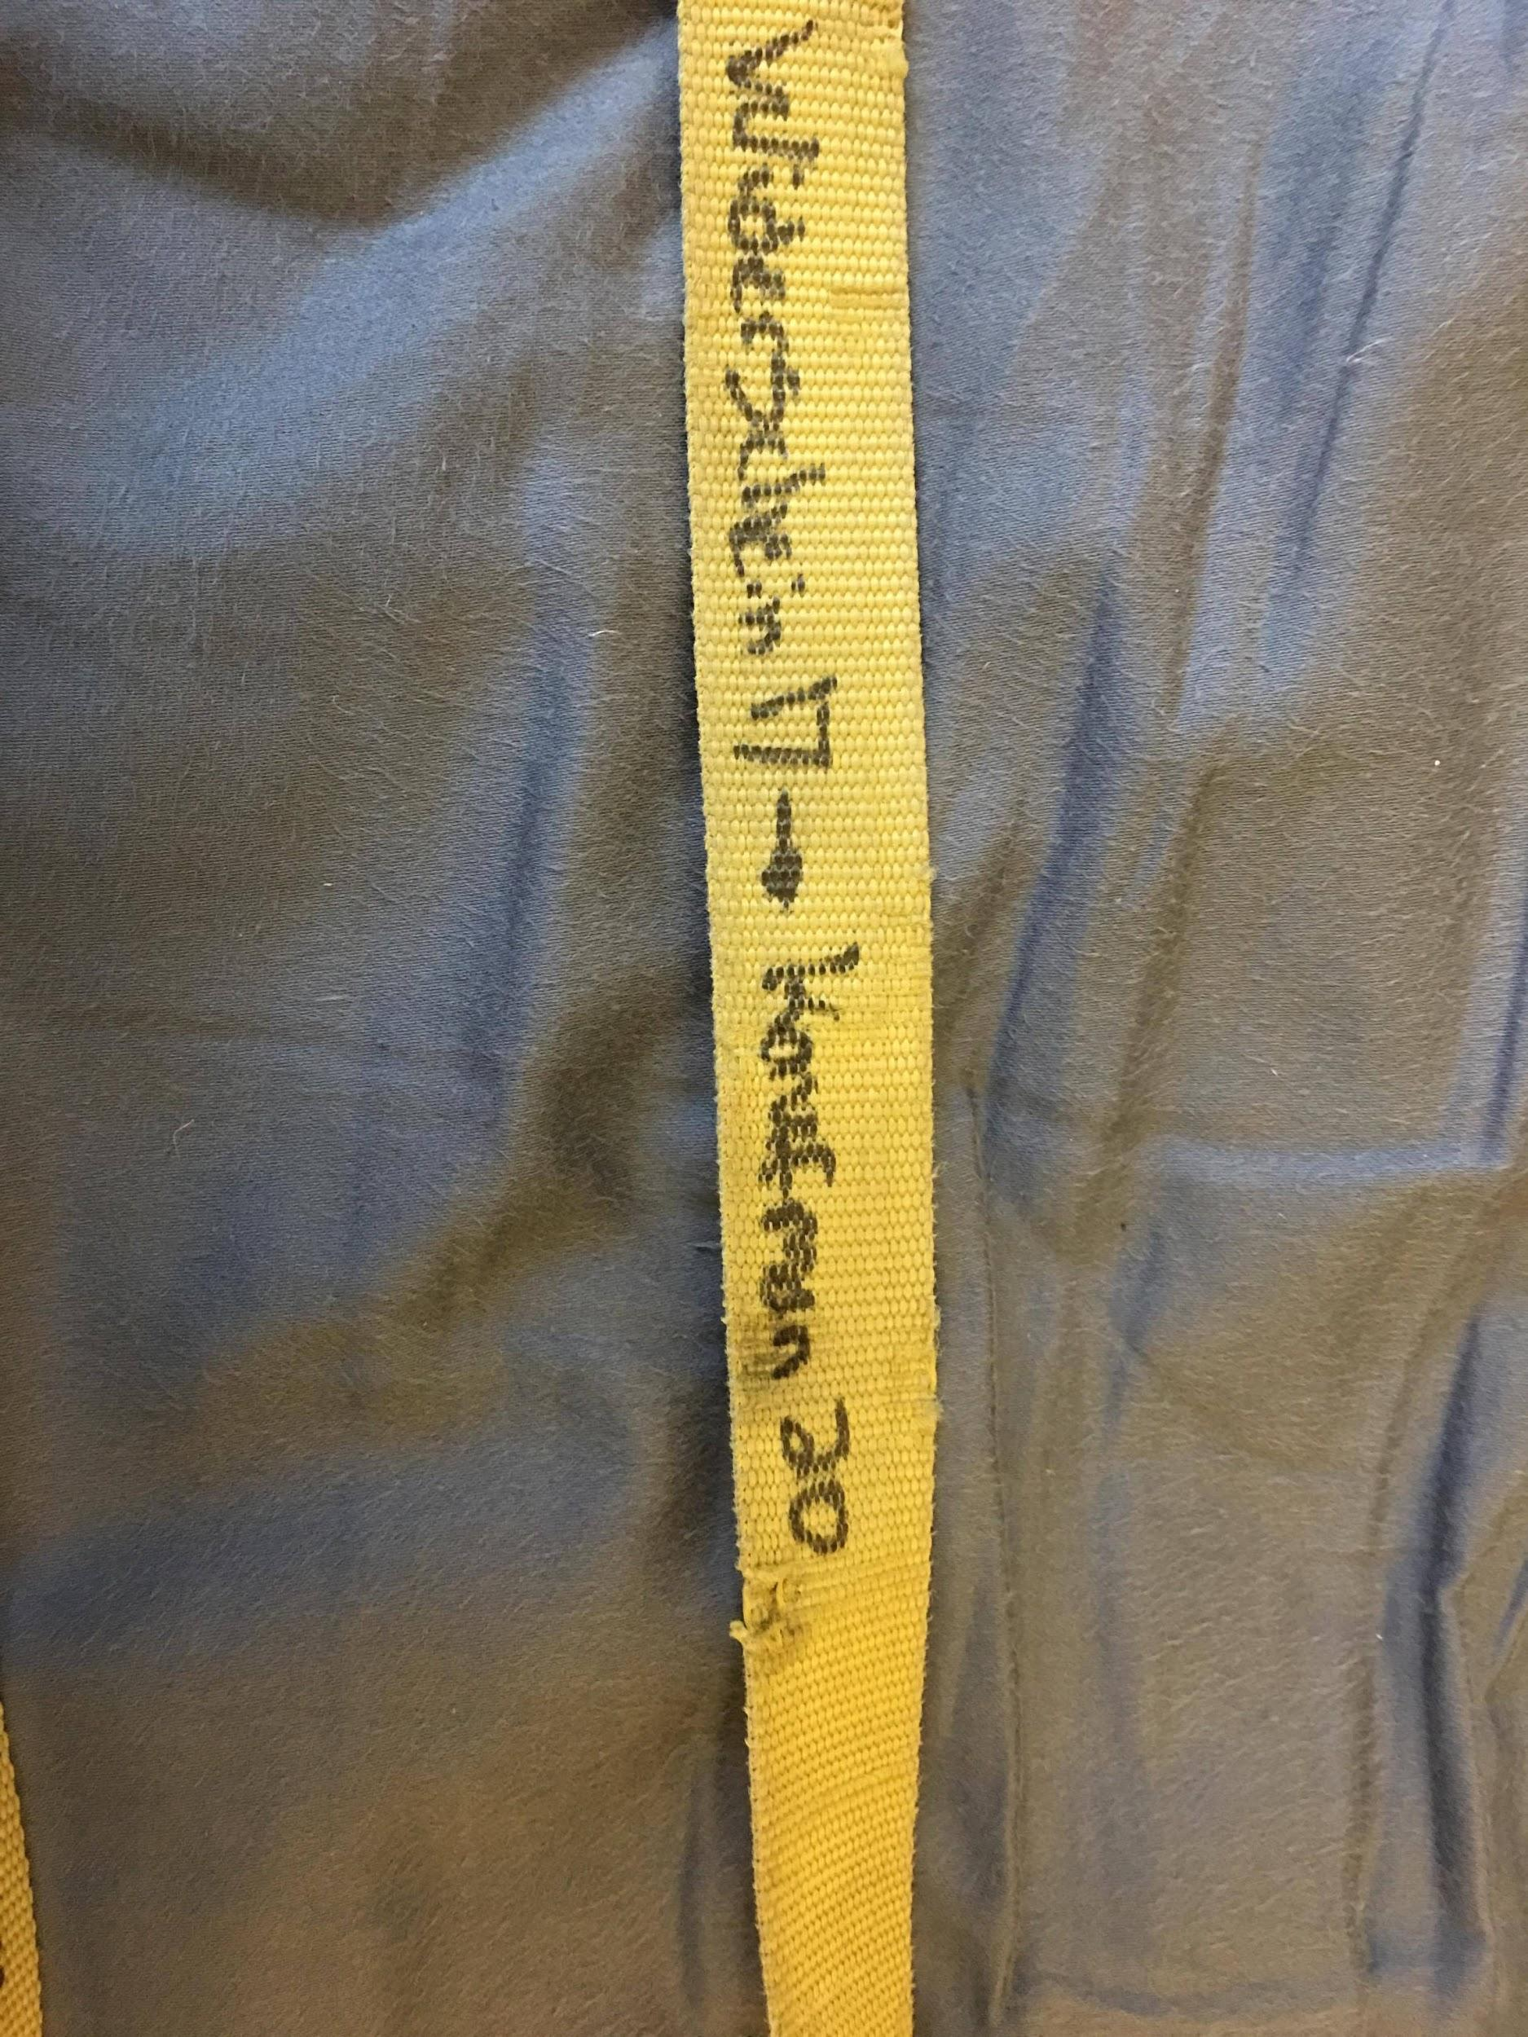
Pocock Belt
Passed down from walk-on to walk-on
Strap used to tie down boats repurposed as belt
Notes:
YP

Slide 15
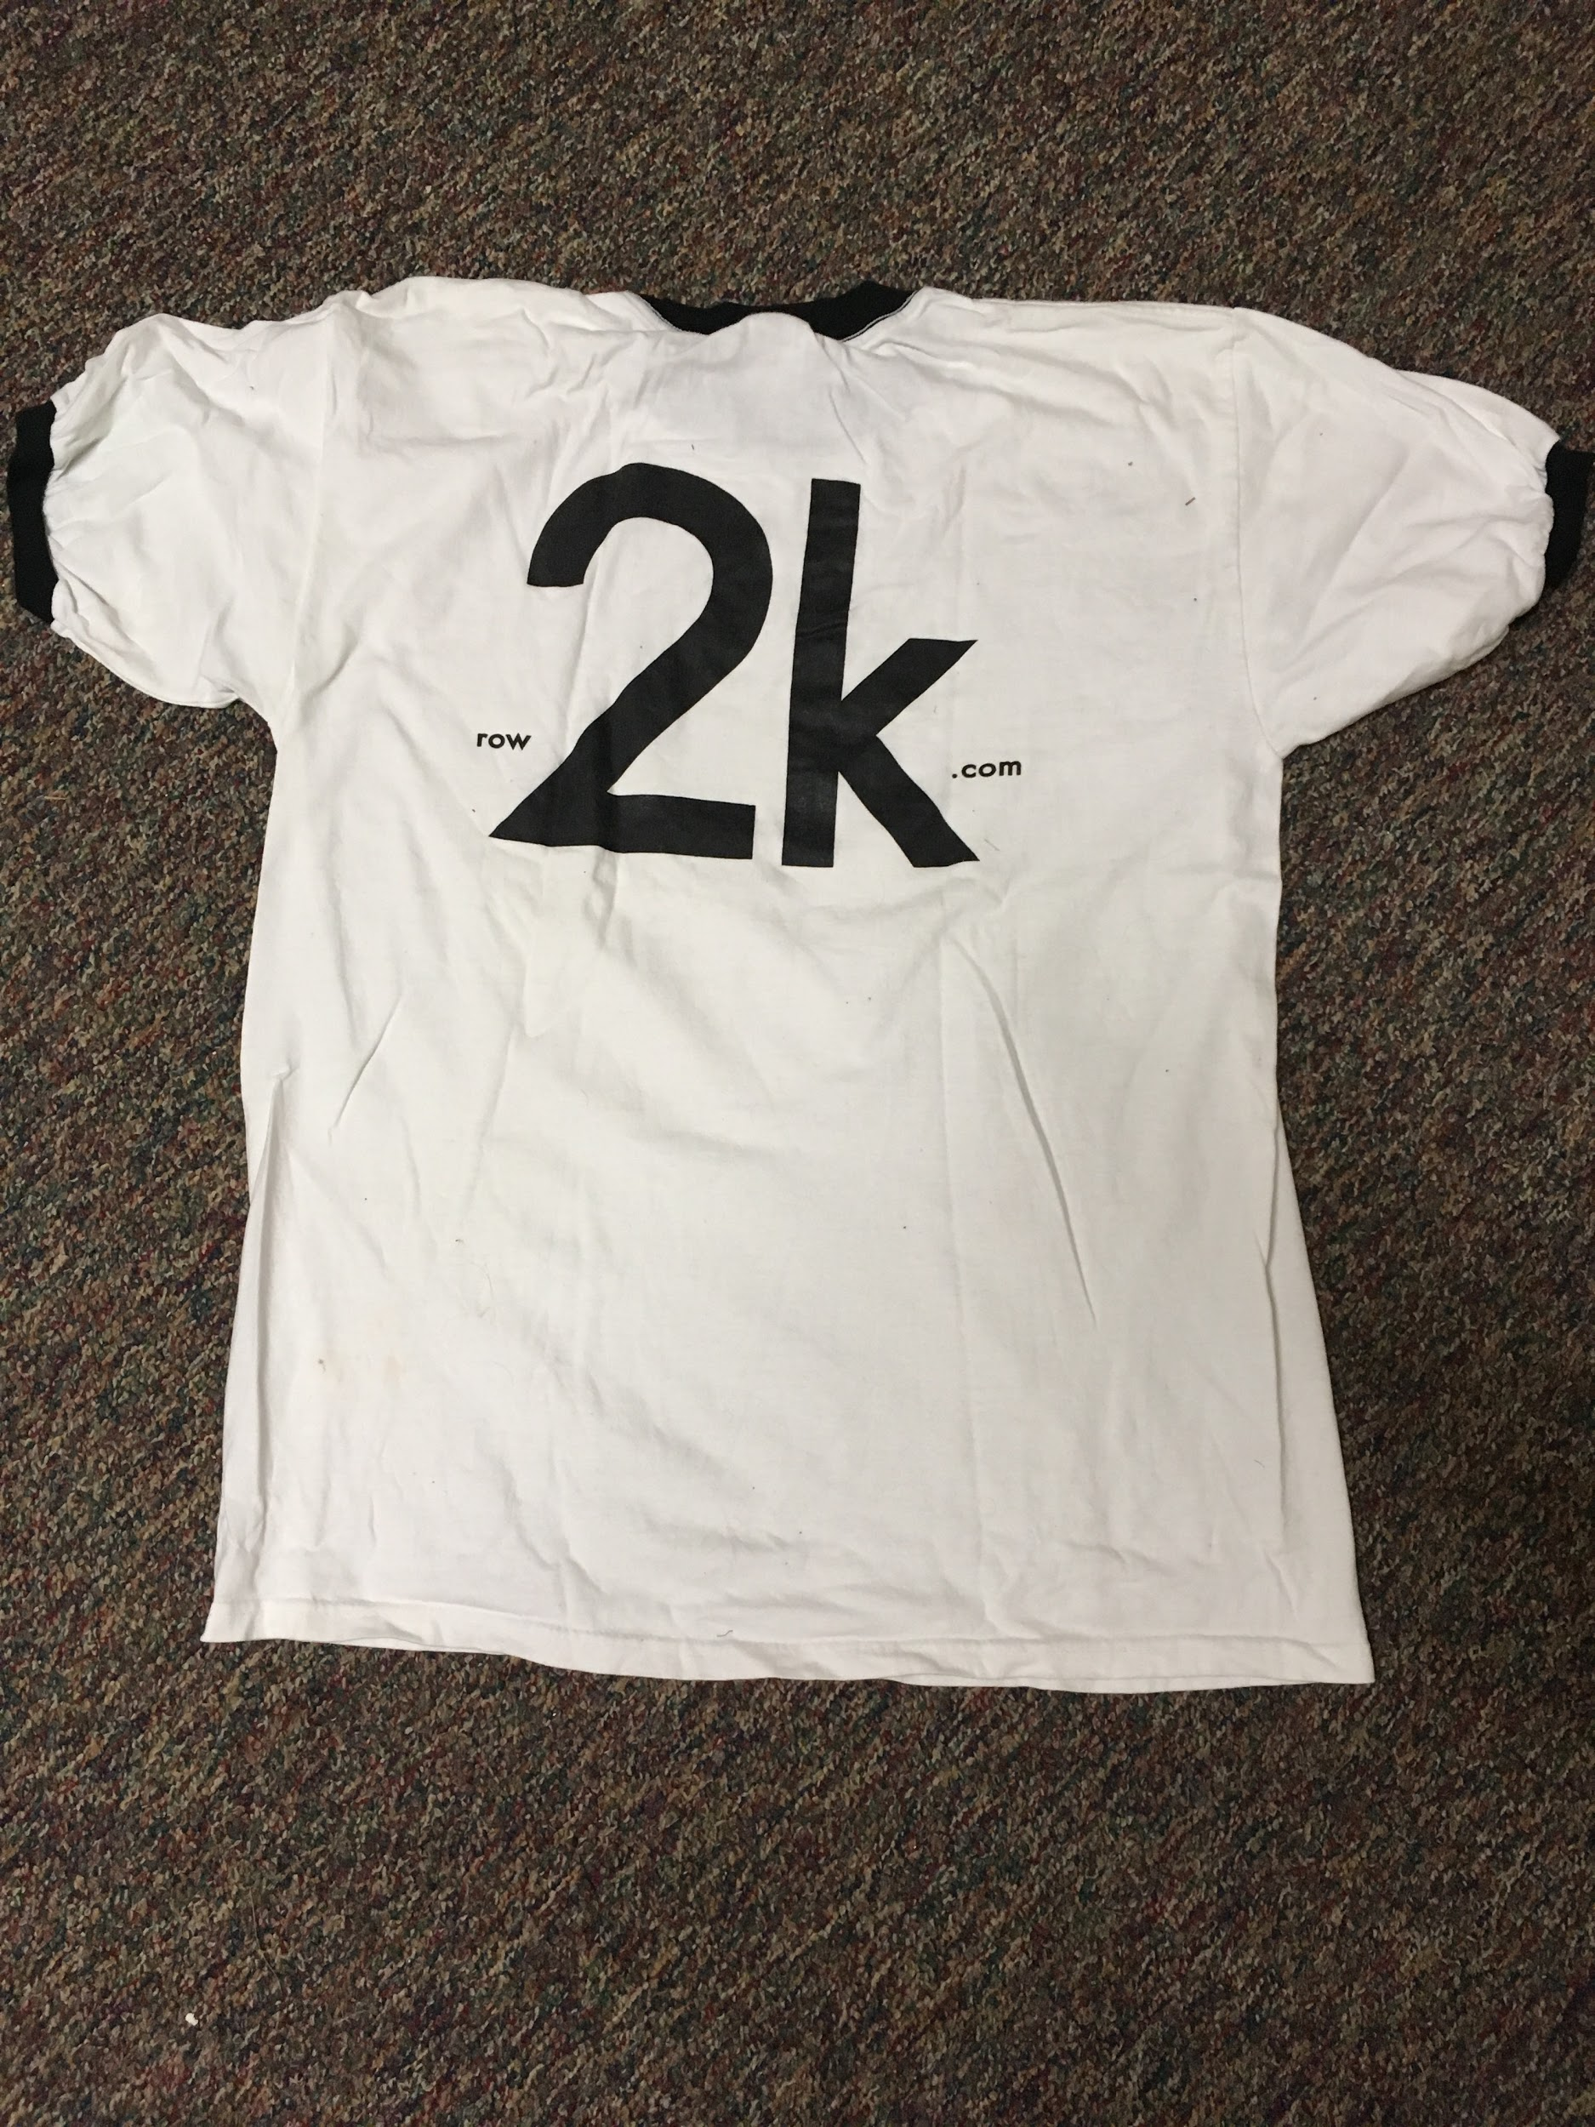
Row2K Shirt
Given to the athlete who knows the most about rowing statistics
Reflects knowledge and commitment to sport
Notes:
YP

Slide 16
Insights and Conclusions
Folklore revolves around:
Sharing common struggles
Acknowledging and remembering past performance/performers
Recognizing great performance or personal growth in individuals
Promoting team bonding
Multi-generational:
Passed down from older to newer rowers
Notes:
BC

