Slide 1
Greek Superstitions
Carmen Braceras, Katie Spanos, Jessica Valvano, Ellen Pattinson

Slide 2
Introduction
Greek Culture:
Superstitions are extremely popular across Greek culture
They are usually passed down from grandparents and parents
Some of them are strictly Greek superstitions, others are observed in other cultures too
Superstitions:
Sign Superstitions: If A, then B
Magic Superstitions: If you do A, then B
Conversion Superstitions: If A, then B, unless C

Slide 3
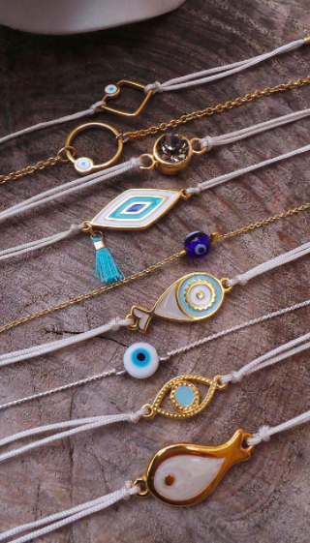
Evil Eye
Sign Superstitions:
If someone looks at you the wrong way, then you will have the evil eye and may begin to feel ill, act strange, cry, or feel pain
Informants: Billy Kosmidis, David Lilla, Vungelia Glyptis, Judith Varlamos, Mary Wallenmeyer, Lia Constantine
If oil mixes in a cup of water, then the person of question is okay, but if the oil spreads then the person is affected by the evil eye.
Informant: Billy Kosmidis
Magic Superstitions:
If you wear a special charm (“philacto”), you will be protected from the evil eye
Informants: Judith Varlamos, Mary Wallenmeyer, Lia Constantine
If a trained person says prayers over clothing of the affected, then they will be cured (CONTAGIOUS MAGIC)
Informants: Mary Wallenmeyer

Slide 4
Social Context:
Can be given accidentally or on purpose by strangers or “bad people” to anyone
People often aren’t aware of receiving the evil eye
Charms commonly worn and given to newborn babies
Processes to identify or cure the evil eye are performed in the home by specially “trained” individuals
Superstition is passed down from parents
Cultural Context:
Recognized by the church as a legitimate religious phenomena
Evil generated by the devil
Serves as an explanation for bad things that occur-- esp. illnesses or pain

Slide 5
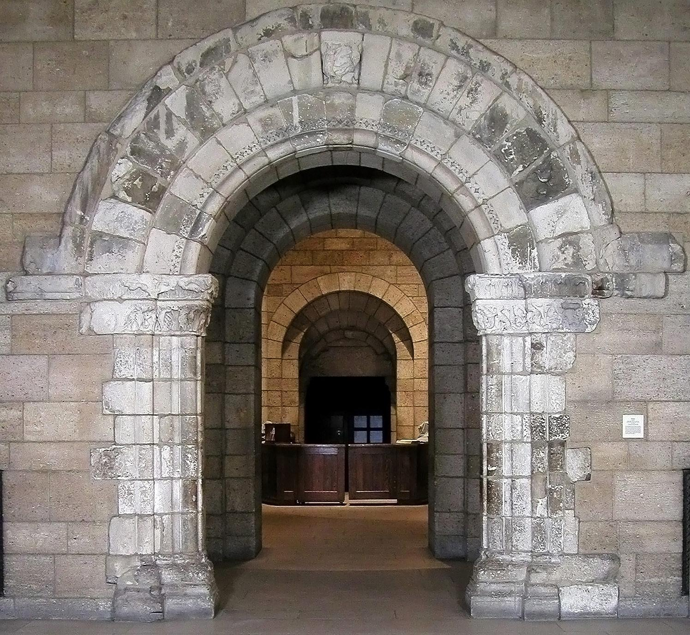
Walking
Sign Superstition (If A, then B)
If you walk across someone’s legs, bad things will happen
Informants: Ally Stone and George Spanos
Magic Superstition (If you do A, then B):
If you don’t walk out of the same door that you entered in, your life will not keep flowing correctly and the single people at the party will never get married
Informants: Vungelia Glyptis, Mary Wallenmeyer, George Spanos

Slide 6
Social Context:
Practiced during events and gatherings (church, weddings, family dinners, etc.)
Passed down through families
Anytime a person enters or exits a building
Cultural Context:
Walking out the same door you entered symbolizes ending or closing the event and not leaving it undone. This is especially important in church gatherings or big family meals.

Slide 7
Pregnancy
Sign Superstition (If A, then B):
(Needle hung from string over pregnant woman’s hand)-- If the needle settles into circular motion then baby is a girl. If it swings back and forth, then baby is a boy.
Informants: Mary Wallenmeyer, Katie Spanos
Magic Superstitions (If you do A, then B):
If a mother eats/touches/interacts with anything red during a certain week of her pregnancy, then her child will have a birth mark.
Informant: Vungelia Glyptis
If you eat pomegranates, you will be more fertile
Informant: Katie Spanos

Slide 8
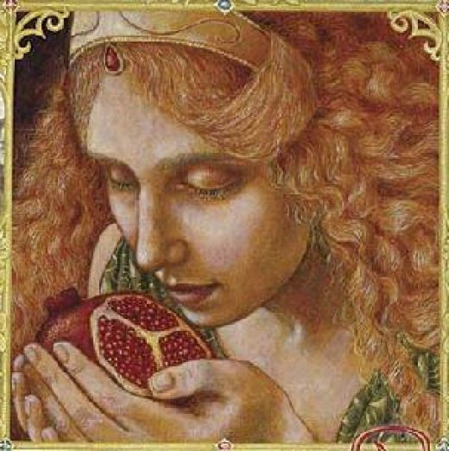
Social Context:
Needle: extended family will practice this on pregnant woman to guess baby’s gender
Red: something familiy members will remind pregnant woman about
Pomegranate superstition: passed from adult female figures to younger women
Pomegranates given to girls and young women by older women to bring them fertility
Cultural Context:
Needle during pregnancy was used before ultrasounds existed, now more of a fun way to predict gender of baby
Red: color is associated with the devil
Pomegranate has mythological ties to Persephone and Demeter (Greek goddess of fertility and harvest)

Slide 9
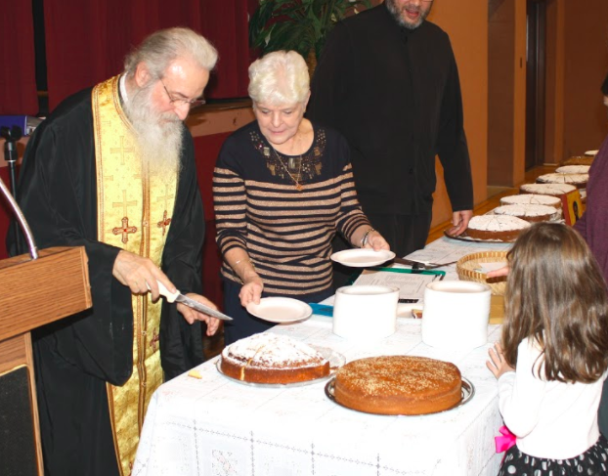
New Year’s Celebrations
Sign Superstitions:
If you receive the piece of Vasilopita cake that has a coin in it on New Year’s Day, you will have good luck all year
Informants: Katie Spanos and Lia Constantine
When you throw a pomegranate on the ground on New Year’s Eve, if it has a lot of seeds, you will have good luck
Informant: Vungelia Glyptis

Slide 10
Social Context:
Both are a gathering of family and friends to celebrate good luck to start the New Year
Often done in church the Sunday before New Year’s among all of the Parishioners
First 3 pieces of Vasilopita cake are given to St. Basil, Jesus, and the Virgin Mary; then, the pieces are distributed oldest to youngest
Cultural Context:
Vasilopita- Thieves took valuables from people. St. Basil became responsible for returning the riches to people but didn’t know how to give them out. Fair way to distribute them was for women to bake cake with valuables inside and distribute pieces of the cake.
Pomegranate- Symbol of prosperity, often hung above the door around christmas until it is broken on New Years

Slide 11
Conclusion
Overall Trends
Older generations believed more strongly in the superstitions, while the younger informants often practiced them for fun but do not value them in the same way
We interviewed people of different backgrounds and their only connection was coming from a Greek family. It was interesting to see how many followed the same superstitions such as the Evil Eye.
Some of the superstitions focused on good and bad luck, but others had very specific consequences/purposes not relating to luck.

Slide 12
Thank you!
Questions?

