Slide 1
Italian Wedding Traditions and Superstitions
Isabella Florissi, Katie Toal, Peter Loomis, Josh Kerber, Sloane Bashford

Slide 2
Italian Wedding Collections
Many regions with their own dialects, identities, customs and traditions
Informant Data:
  3 males, 2 females
  2 professors, 2 students, 1 UGA
  Ages 21-39
  All from various regions of Italy
Collected material, customary, and verbal folklore
  Ex: Food, rituals, superstitions, proverbs
Notes:
Josh

Slide 3
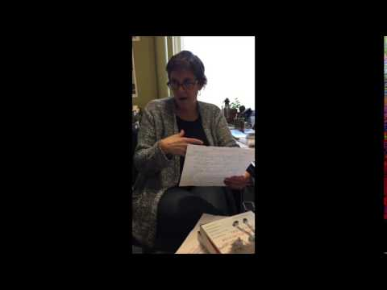
Notes:
Josh

Slide 4
Moglie e buoi dei paesi tuoi
“Wives and oxen come should be acquired in your own city”
Literal Translation: Wife and oxen of your towns.
Shouldn’t marry or get live stock outside of your own city
Encouraged separate identities and individual customs in Italy
Notes:
Josh

Slide 5
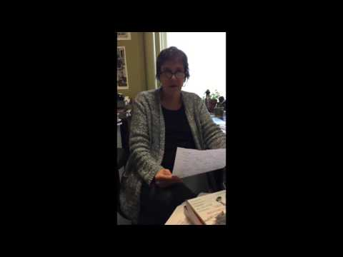
Notes:
Isabella

Slide 6
Di venere e di marte non si sposa
“One should not get married on Tuesday or Friday”
Literal Translation: “Don’t get married on Mars’ or Venus’ day”
Mars is the God of war, related to Tuesday
Friday is the day that evil spirits were created
Notes:
Isabella

Slide 7
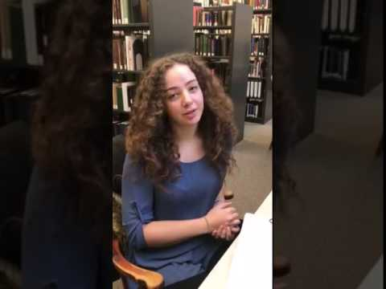
Notes:
Isabella

Slide 8
Auguri e figli maschi
“Congratulations and I hope you have male babies”
Literal Translation: Best wishes and male children.
A common toast or wish of good luck to a couple
Notes:
Isabella

Slide 9
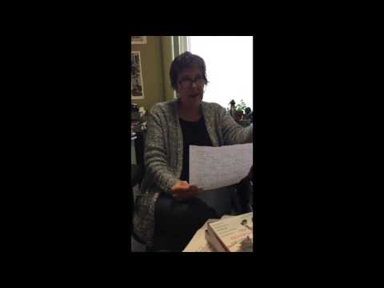
Notes:
Katie

Slide 10

Sposa bagnata sposa fortunata
“If it rains on one’s wedding day, it is supposed to be good luck”
Literal Translation: A wet bride, a lucky bride
Related to:
  Fertility
  Growth
  Luck
  Purity
Magic: Law of similarity
Notes:
Katie

Slide 11
The Cutting of the Groom’s Tie
North of Italy
Auction off a piece of the groom’s tie
To raise money for the couple and represent the money that the couple will earn in their lifetime
Customary folklore
Contact magic: The tie was in contact with the husband and thus it represents a part of him
Notes:
Katie

Slide 12
Confetti In Groups of 5
Superstition: Bad luck to have a number of confetti that is not a multiple of five
If A then B: receive confetti in multiples of five and there will be no bad luck
Follows the law of similarity - each piece of confetti symbolizes a positive quality, such as wealth and fertility
Notes:
Sloane

Slide 13
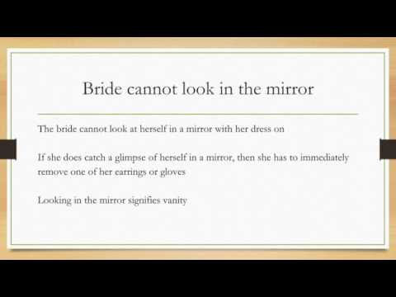
Bride cannot look in the mirror
The bride cannot look at herself in a mirror with her dress on
If she does catch a glimpse of herself in a mirror, then she has to immediately remove one of her earrings or gloves
Looking in the mirror signifies vanity
Notes:
Sloane

Slide 14
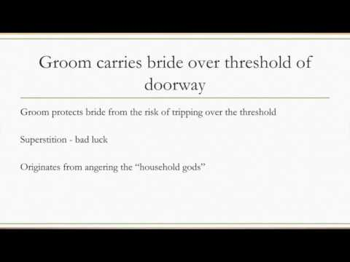
Groom carries bride over threshold of doorway
Groom protects bride from the risk of tripping over the threshold
Superstition - bad luck
If A then not B: If she is carried over the threshold, the couple will not have bad luck
Originates from angering the “household gods”
Notes:
Peter

