Slide 1
Horror Folklore
Andrew Alini, Alexandra Collins, Roko Glasnovic, Sarah Perez, Sydney Zhou

Slide 2
Informants/Items
Total items collected:15
Urban Legends: 4
Campfire Stories: 11
Female: 10
Male: 4
Dartmouth students: 12
Non-Dartmouth students: 2
Collected items though audio and video interviews

Slide 3
Urban Legends

Slide 4
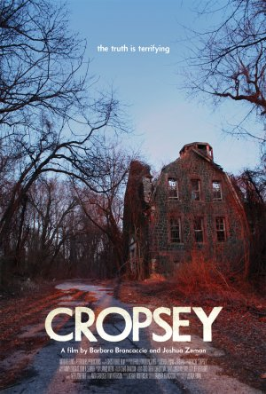
“Cropsey”
Escaped mental patient from Willowbrook Mental Institution on Staten Island
Abduct and kill children
Cropsey is like a boogeyman
Documentary was made about the legend in 2010

Slide 5
Analysis
Modern folklore
Thought as true, but not confirmed if story is true or not
Willowbrook Mental Institution was a real place → historical content
Multiple variations of the story

Slide 6
“Bloody Mary”
Halloween Horror Nights 2008 Trailer
Universal Studios - Orlando, Florida

Slide 7
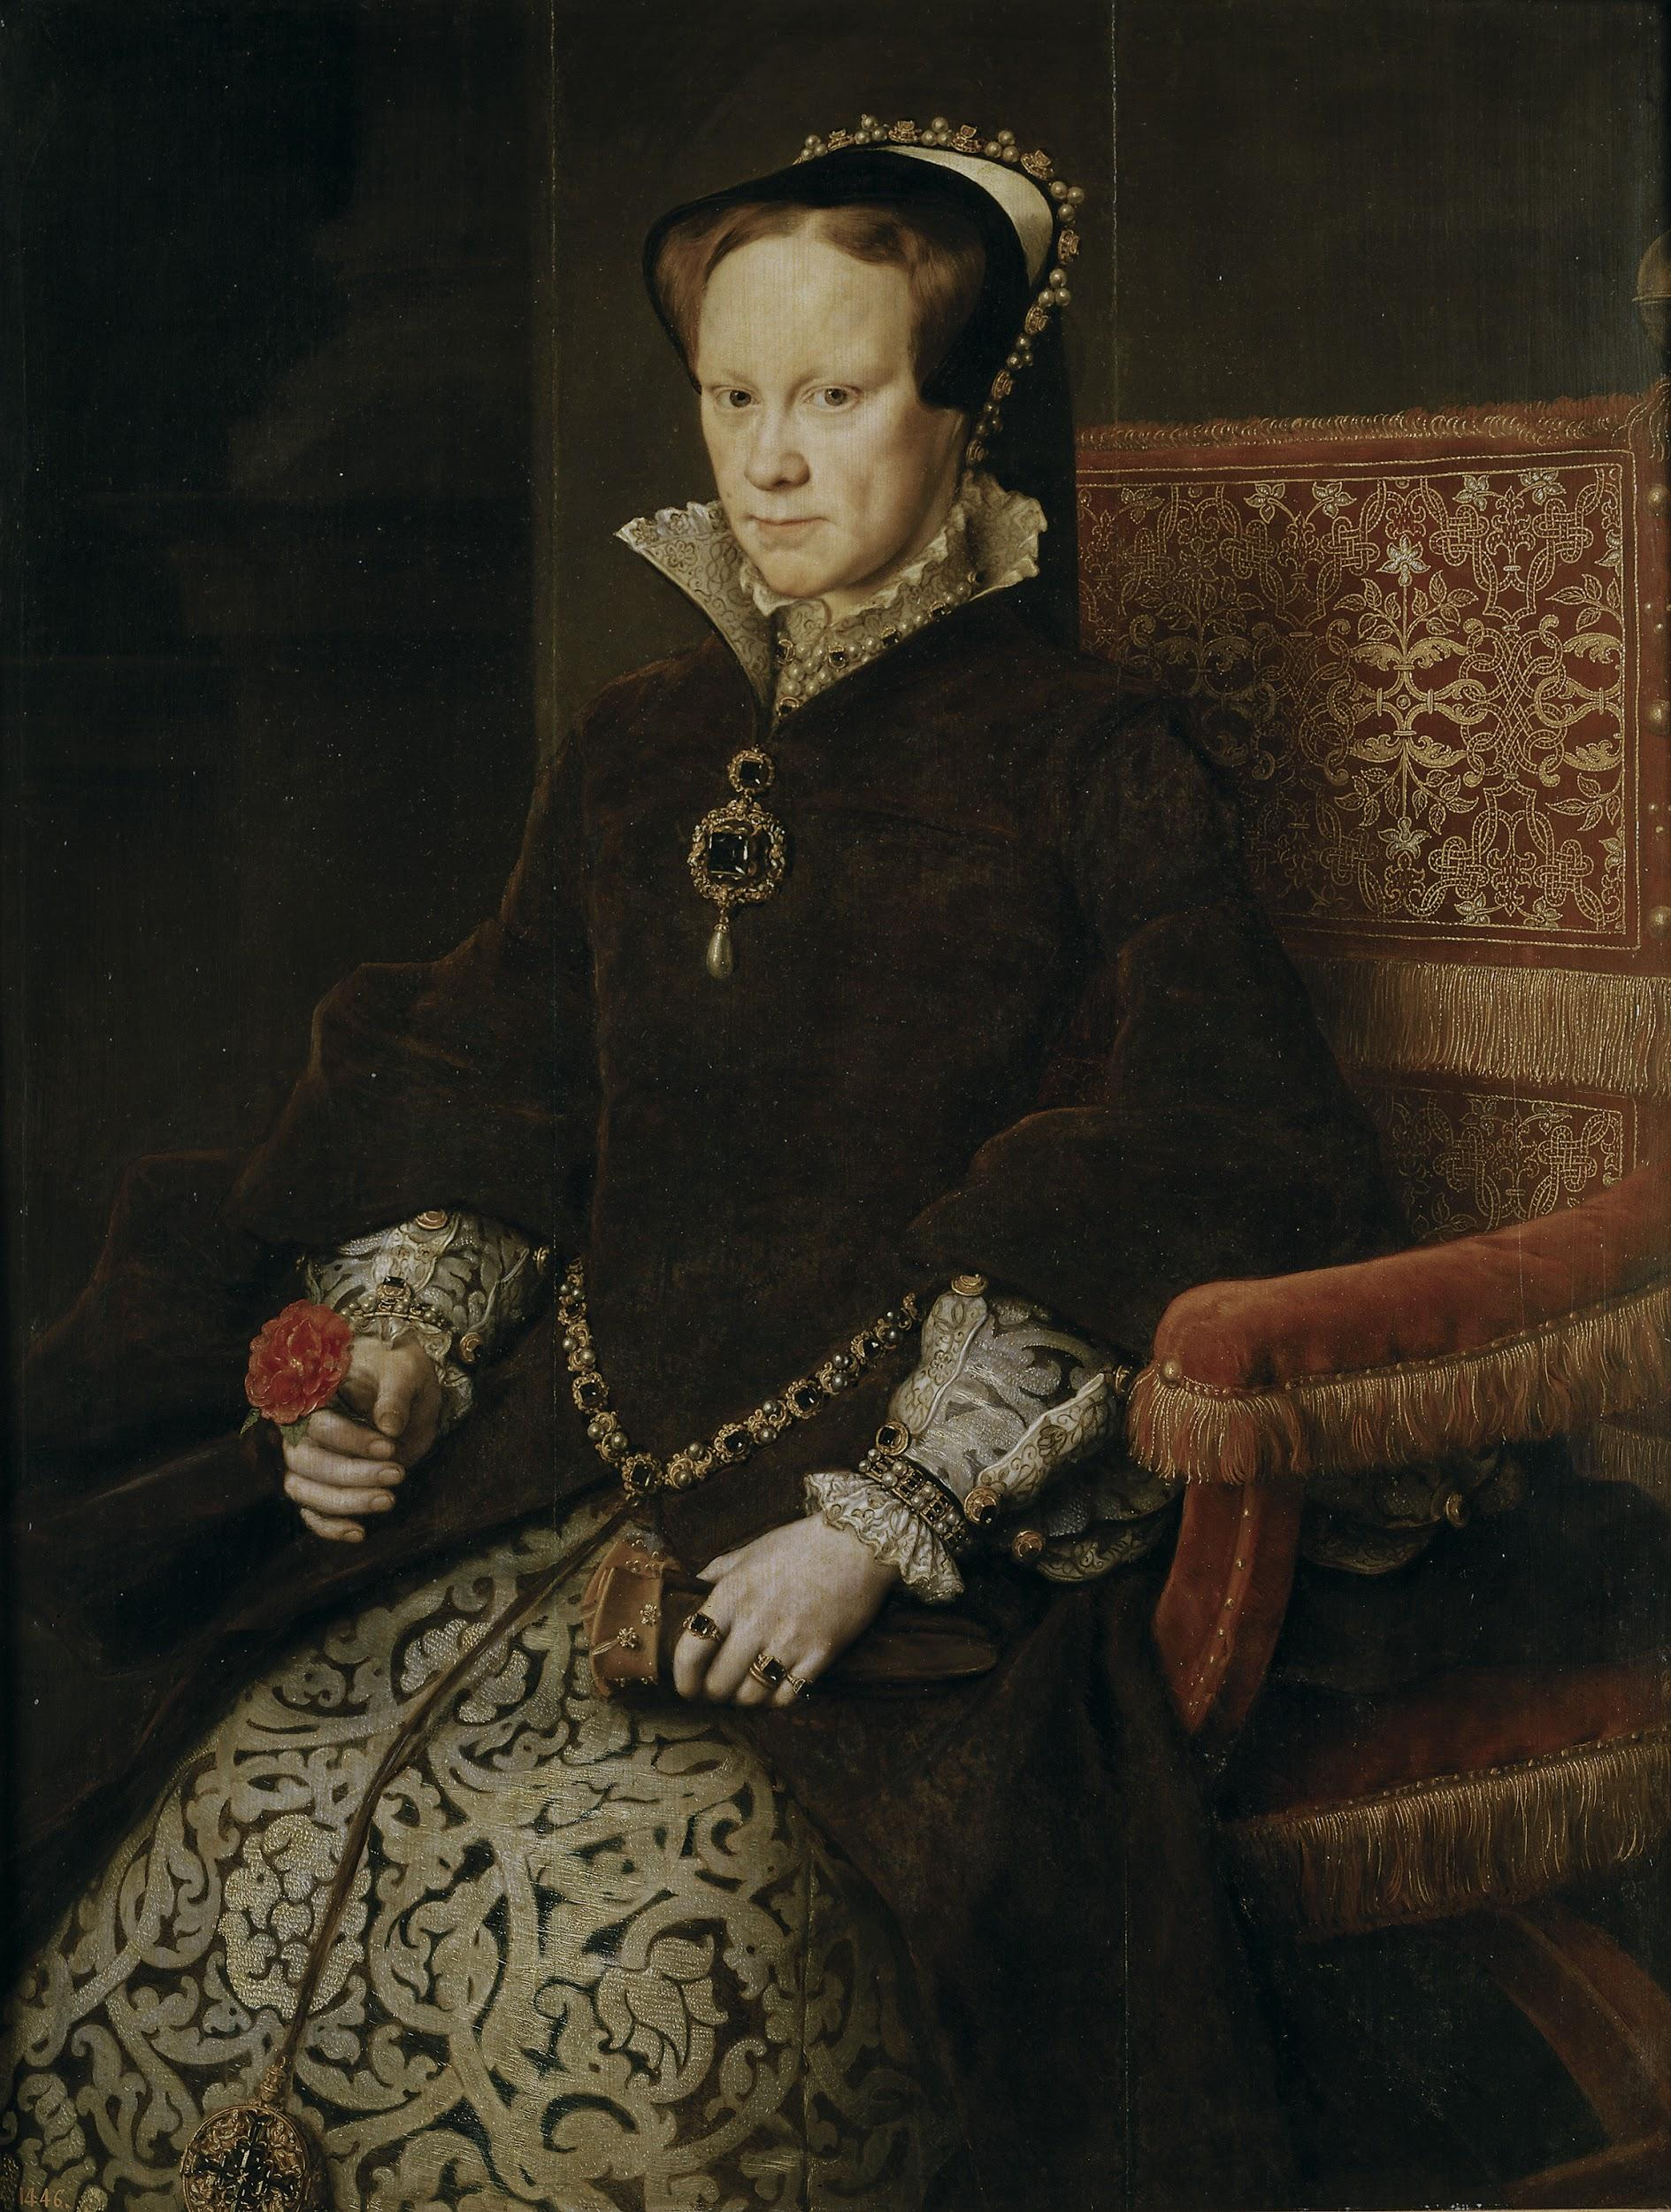
How did we get here?
“Bloody Mary” = Mary Tudor, Queen of England and Ireland (1553-1558)
Only child of Henry VIII and Catherine of Aragon to survive to adulthood
Ruled as a staunch Catholic; burned many Protestants at the stake on charges of heresy
Need for an heir to the throne → “Ghost pregnancy” (1554)
Generally led an unhappy life… Henry VIII disavowed her as illegitimate; sent away her mother; made her a servant of younger half-sister (future Queen Elizabeth I)

Slide 8
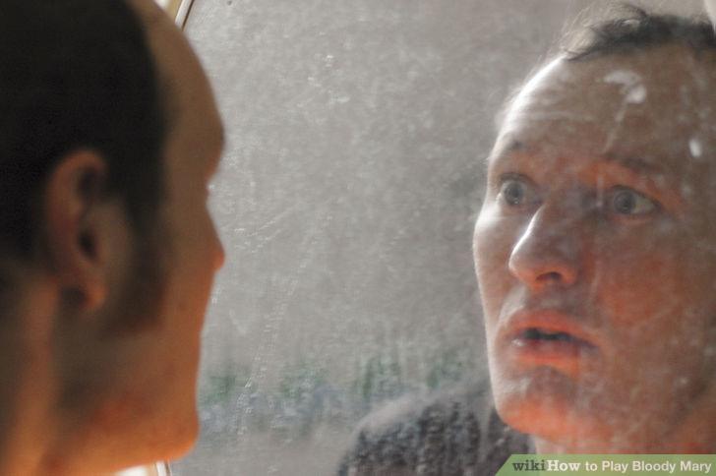
The “Game”
Most of us probably played at least once during childhood
Usually in the context of a dare
Several variations…
Number of players (usually 1-3 people)
Bathroom door locked v. unlocked
Candle v. no candle
Running water v. no running water (e.g. faucet… may help summon her)
Chant
Say “Bloody Mary” over and over again (usually 13 times)
Taunting; “I stole your baby, Bloody Mary…”

Slide 9
Analysis - 3 Main Takeaways...
How does this relate to what we have studied thus far?
Game usually played in the context of a dare
Analogous to test in the fairytale; demonstration of bravery/courage
Several variations; game doesn’t really have a creator
Emphasis on the collective
Urban legend circulated by word of mouth/practice
Historical basis
E.g. Bloody Mary was an actual person…
Similar to Vlad Tepes (Dracula), Saint Nicholas (Santa Claus)
15th century and 4th century; respectively

Slide 10
Campfire Stories

Slide 11
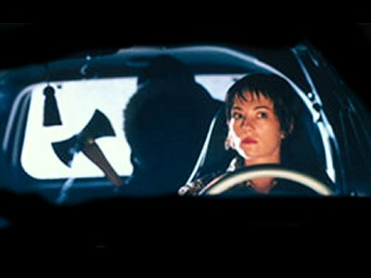
“The Man in the Backseat”
Story
There is a woman driving on desolate road. A car following her starts honking repeatedly.
Unbeknownst to her, there was a man in the backseat with a knife trying to kill her.
Analysis
Story exists in variations
Trebling used to build up suspense
Doesn’t exactly follow scary story structure

Slide 12
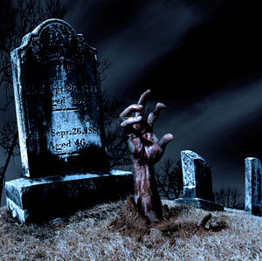
“The Girl in the Graveyard”
A group of teenagers were having a party near the graveyard
They shared scary stories and one of them included the graveyard and the superstition connected with it
A girl didn’t believe them and decided to prove that the superstition is fake
She went there, picked a graved and stabbed a knife in the grave as a proof that she did it
The girl disappears and they never see her again

Slide 13
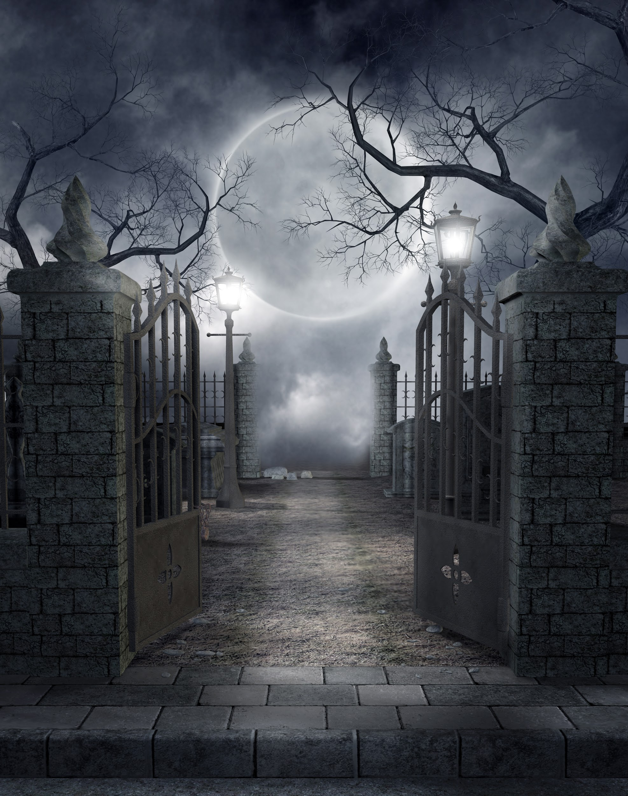
Analysis
An example of customary folklore
Many different variations of the story and its ending
No fixed form
Authorless
Depends on the performer
Present in many different cultures

Slide 14
“Dog Lick”
A little girl is home alone for the first time and only has her dog with her
She locks all the doors and windows and always has her dog sleep right under her bed, when she got scared she puts her hand down and would pet her dog and her dog would lick her hand
The girl then goes to bed but sometime in the middle of the night she hears whimpering and strange noises so she puts her hand under her bed and she feels a lick on her hand so she goes back to bed
This happens repeatedly until she wakes up to a new noise and gets up and walks down the hall to the bathroom to investigate
When she walks in and turns on the light, she sees a pretty gruesome scene with her dead dog hanging in the shower

Slide 15
Analysis
Different variations of the story
No real ending
Authorless
Suspense is built throughout the story

Slide 16
Analysis/Conclusion
Stories themselves may not be that scary when seen in text
Stories become scary through the way the story is told (based on storyteller’s tone)
Stories are a form of entertainment
Play off of human fears that might be irrational
Stories exist in variations
Stories can differ from the scary story form

